Slide 1
Business DNA®
Team Performance Process
For Navigating Human Differences to
Transform Business Performance
April 2014

Slide 2
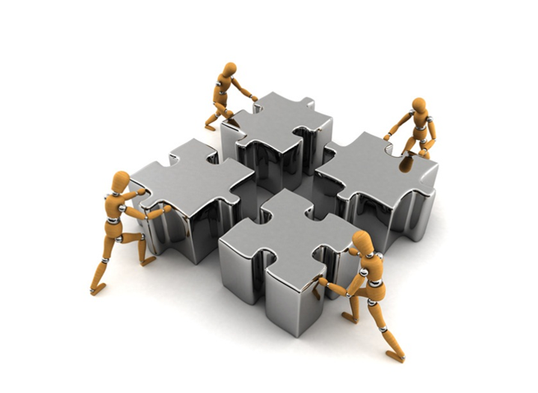
Team Performance Challenges
Understanding why different team members naturally do things differently.
Hiring the right talent to perform in the team.
Managing team members uniquely and aligning them to a common goal.
Identifying and unlocking the blockages to efficient execution.
Building open communication within the team and allowing creative conflict.
Building higher levels of team engagement leading to longer retention.
Matching team and customers for improved service and retention.
Notes:
Now lets start taking you on the path to DNA Advisor Performance. I will start walking you through the methodology using the case study of Chris Coddington, which is laid out in my Financial DNA book.
The issue I have seen for most advisors and clients is seeing through the clutter and confusion to choose between the many options that exist.
Choosing what is an opportunity goes back to your life purpose…..Your life purpose is at the core of your decision making matrix for building a quality life and your business. Getting in touch with your life purpose will help you align your natural talents, passions and values to what you do every day. Everything else is a distraction and an energy drain. When you get to understand this you will really feel it.
Having a concrete written plan based on your life purpose will help you focus on the opportunities and minimize these distractions. This is what we help you create using behavioral insights as the starting point.

Slide 3
Why a Human Behavior Approach for Teams
… provides a superior platform for:
In-depth understanding of talents in the team
Recognizing and navigating individual differences
Dealing with each other in stressful times
Open communication with less emotion
Appropriate and tailored information flows to different team members
Objectively resolving conflict/problems
Ability to quickly uncover critical below-the-surface operational issues
Increasing profits from improving execution with better team work

Slide 4
The 6 Pillars of DNA Team Performance
1.Leader Review
For the Leader to Understand their Natural Leadership Talents to Build a Healthy Team and Identify the Team Issues for Increasing Revenues
2.Team Member Review
For Each Individual Team Member to Understand their Natural Talents for Performing their Role in the Team
3.Team Meeting
A Team Meeting to Align the Team for Greater Productivity to Achieve Team Goals
4. Team Relationships
Each Team Member to Learn How to Adapt their Communication to Engage and Interact With Others in the Team
5. Leader Coaching
For the Leader to Lead from the Front and Coach Each Team Member Based on their Unique Talents
6.Team Monitoring
Quarterly Team Reviews to Monitor Team Performance and Health
Notes:
4

Slide 5
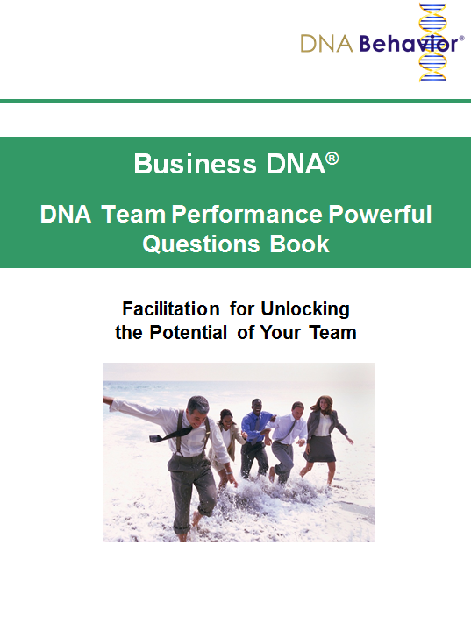
Summary of the Team Event Process
Set up the Business Discovery Process for each participant and completion of Team Performance Score Card
Organize presentation slides and materials for each person: Individual Reports, Team Report, Unlocking Guide and DNA Team Performance Plan
Meet with team leader before the session - brief, mentor, find unique gift, purpose, prepare to become vulnerable, identify team and business issues
Meet with each team member before the session – identify unique gift, purpose, role, issues, prepare for team event
Team event structure
Ice-breakers
Core Program – Using the DNA Team Performance Plan
Optional segments – The 5 Dysfunctions, Leadership, Business Planning, Hiring, Succession etc
Meet with Team Leader – post session de-brief

Slide 6
DNA Team Performance Curriculum
Leader Review Deliverables:
Business DNA Natural Behavior Discovery
Personal Performance Plan
Program Structure
Modules Delivered in Group Sessions, Virtually and In Person, with 1:1 performance coaching of team members
Program Customized to Meet Team Needs
Business DNA Discovery Process and Resources
2. Team Member Review Deliverables:
Business DNA Natural Behavior Discovery
Personal Performance Plan
3. Team Meeting Deliverables:
Business DNA Team Report
Powerful Questions for Teams
4. Team Relationship Deliverables:
Business DNA Comparison Reports
DNA Ultimate Performance Card
DNA Unlocking Human Capital Guide
5. Leader Coaching Deliverables:
DNA Leadership Performance 360 Discovery
DNA Leadership Performance Report and Plan
Powerful Questions for Leaders
6. Team Monitoring Deliverables:
DNA Team Performance 360 Discovery
DNA Team Performance Report
Notes:
Group based curriculum with up to 10 per group – interactive – assignments - compatibility matching – participants carefully selected – need to commit time outside the webinars to achieve value
Value for $6000
Framework to double revenue and increase personal income by 3x
Savings of over $2000+ in purchasing DNA Tools

Slide 7
The 6 Pillars of DNA Team Performance
Leader Review Deliverables:
Business DNA Natural Behavior Discovery
Personal Performance Plan
Process:
Team Leader to Complete the Business DNA Natural Behavior Discovery to improve their self awareness for leading and interacting with their team, and to identify leadership blind spots.
Notes:
The starting point is always personal performance.
Who you are is foundational to all the other 5 pillars and each decision that you make.
You have to get yourself right first before getting the business right. The person who is most in your way is you. After all you are the driver of your business.

Slide 8
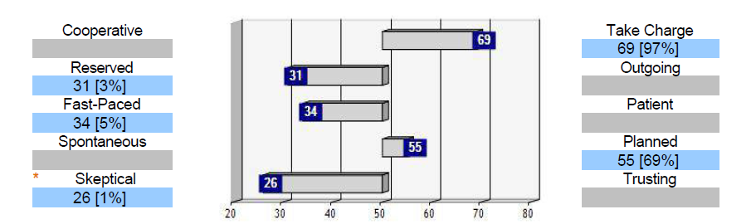
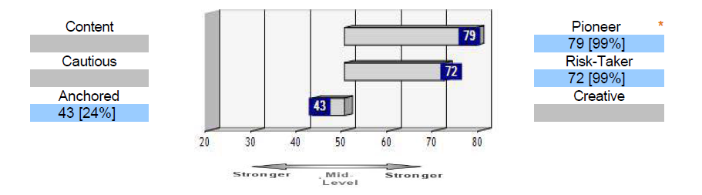
Identifying Your Natural Behavior Style for Leadership
Chris Coddington - Strategist
Skeptical Strength:
Questioning and guarded
Skeptical Struggle:
Too doubting and wary
Pioneering Strength:
Goal orientated and ambitious
Pioneering Struggle:
Too driven and success focused
Notes:
How are you hard-wired for performance?
What does “Hard-Wired” mean to you?
This is the Behavior that is ingrained or programmed into you – the repeatable behavior that you cannot learn – but for many of us we do not truly understand our own and that of others – we all have blind-spots – and some of us do not want to know these. Most personality assessments do not bring out the hard-wiring rather, they reveal the learned and preferred behavior which changes in different situations.
Our hard-wiring is the foundation of our success formula and that for our clients – the more we are in touch with it the better we can do. This is why the Financial DNA Path reports deliberately identify your innate strengths and struggles so you can find your success formula.
Maximum performance with the least stress comes from using your natural strengths (talents) and managing your struggles so they do not become a weakness and get in the way of your success.
Here is a sample Business DNA profile.
Explain scoring:
45-55 is mid range, 44 to 20 is low and 56-80 is high –more intensive the closer we go to 20 and 80
Profiles are right for 90% of people 90% of the time
Results are stable
No good or bad profile
No decision should be made solely based on the profiles.
As we look at Chris, we can see he is a take charge, fast paced and risk taking person
What are the coaching points for Chris? Where could he get in the way of himself?
Too many risks
May not listen
Tends to be too rational

Slide 9
Pre-Team Discussion With Team Leader
Generally ask the following questions, along with questions about other specific issues you become aware of from discussions with the leader or other persons in the business
Allow 1 hour for this discussion, although sometimes it may be a 15 minute conversation.
Confirm the event start and end times to make sure you are on the same page as well as any other logistics such as location, dress, etc. These should have been worked out at least two weeks in advance with the event coordinator but it’s good to make sure that both your thinking is aligned.
What would you like to accomplish for the team event? Goals? Etc.
What are your perceptions of business problems and key management issues? How does this relate to the Team Performance Score Card?
What is your leadership style?
What is each person's role in the team?
Are there any serious problems with the team? This is pretty open-ended and gives them an opportunity to reflect on the state of the team and also individuals.

Slide 10
Pre-Team Discussion With Team Leader
Identify the differences within the team. [For instance, long time personality clashes that are hindering teamwork which should be discussed in the team meeting.]
Is there anyone you have a serious concern about whether they will make it in their role or with the team?
If you have any real disconnects between the DNA Natural Behavior Style and your perception of the person then this is a good time to ask?
Ask the team leader if he/she wants you to tell him/her about each of the people. So always have the one page combined graphs in front of you to talk to them as needed. They are usually very surprised at how much we can know about people we have not met.

Slide 11
The 6 Pillars of DNA Team Performance
Process:
Each Individual Team Member to Complete their Business DNA Natural Behavior Discovery to improve self awareness for performing their role and interacting with their team, and to performance blind spots.
2. Team Member Deliverables
DNA Natural Behavior Discovery
Personal Performance Plan

Slide 12
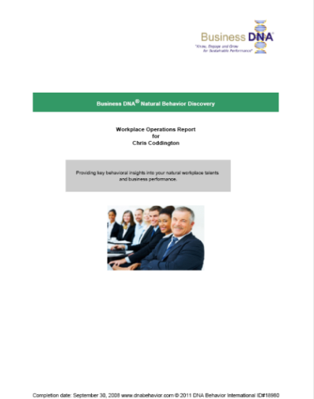
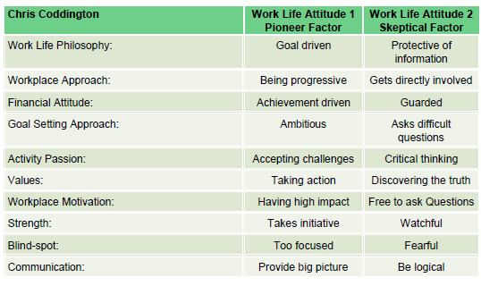
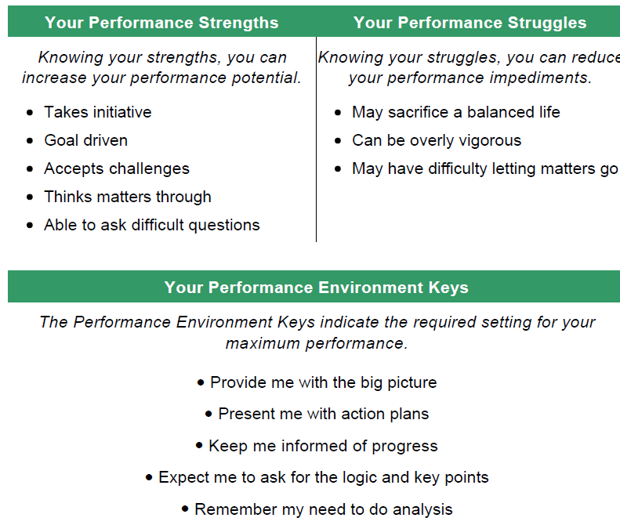
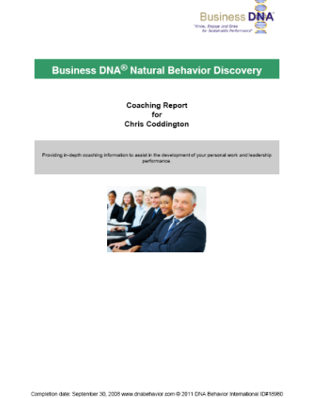
Identifying the Strengths and Struggles of Employees
Workplace Operations Report
Work Life Behavioral Attitudes and Ultimate Performance Guide
Have you got the right people on the team?
Are they productively using their talents?
Is the team properly focused on client service execution?
What are the impediments for high performance?
Coaching Report
Notes:
12

Slide 13
The 6 Pillars of DNA Team Performance
Process:
Prepare the Business DNA Team Report and organize a team meeting to address the strengths and struggles of each team member to build greater alignment and team health for achieving team goals.
3. Team Meeting Deliverables:
Business DNA Team Report
Powerful Questions for Teams

Slide 14
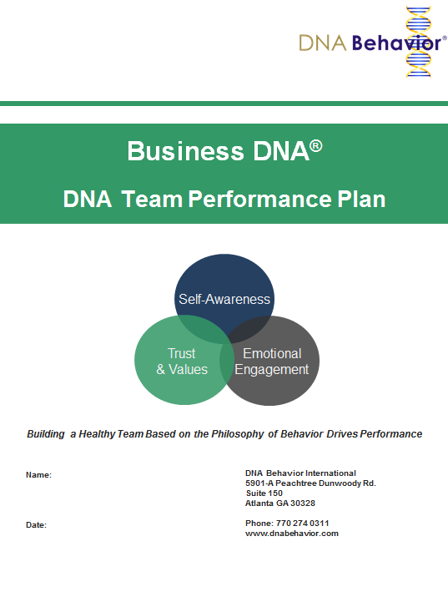
Building a Healthy Team
The path to a healthy team:
Begins with an awareness of how each of us is different
Communicating with each member on their terms
Is grounded in honest appraisal and feedback
Requires trust between team members and of the leadership
For Team Programs use the Team Performance Plan

Slide 15
Closing the Behavior Performance Gap for Teams
+70%
Team Productivity Gains*
Team Growth Drivers:
Operational Competence
Team Results
Team Leadership
Team Communication
Customer Engagement
Supplier Engagement
Team Sustainability Drivers:
Team Trust
Team Values
*2009 Gallup Research

Slide 16

DNA Team Performance Model
TRUST
D
I
F
F
E
R
E
N
T
C O M M U N I C A T I O N S
T
A
L
E
N
T
S
UNITY
ALIGN
Team Success
UNDERSTANDING
ACCEPTANCE
RESPECT
TRUST
ALIGN
C O M M I T M E N T
UNITY
TRUST
Team Development:
From Diversity to Unity to Success

Slide 17
Necessary Ingredients of a Healthy Team
Same
Mission
Commitment
Corporate Values
Opportunity/Loyalty
Policies/Discipline
Different
Talents
Motivations
Ideas/Interests
Needs
Styles

Slide 18
First Break All The Rules
What the world’s greatest managers do differently.
By Marcus Buckingham and Curt Coffman, 1999 by Simon & Schuster
Great managers on differences:
“They recognize that each person is motivated differently, that each person has his own way of thinking and his own style of relating to others…
But they don’t bemoan those differences and try to grind them down.
Instead, they capitalize on them. They try to help each person become more and more of who he already is.”
Great managers would offer this advice:
Focus on each person’s strengths and manage around his weaknesses… Help each person become more of who he already is.
This radical insight is fueled by one simple insight: Each person is different.

Slide 19
Team Activity 1: My Best Team Mate
My Best Team Mate (Behaviors, Values, Characteristics)
1.
2.
3.
4.
5.

Slide 20
Team Activity 2: Your Likeability Factor
What is your Likeability Factor? Go around the room and each person in the team to state a quality they like about another person. The team leader is the first to receive their “likeability” feedback from the team members. Write down your likeability feedback in the table below. Then progress to each person one-by-one.
Likeability Feedback from Team Mates | How Are You Empowered ? | How Can You Improve?
1.
2.
3.
4.
5.
6.
7.
8.
9.
10.
11.
12.
13.
14.
15.

Slide 21
Team Activity 3: Analysis of Our Current Team’s Performance
Analysis of Our Current Team’s Performance
Team Strengths | Team Struggles
1. | 1.
2. | 2.
3. | 3.
4. | 4.
5. | 5.

Slide 22
Taking Team Performance to a New Level
Review How Your Team is Performing
Business DNA Team Performance Score Card
12 Keys to Successful Teams
Rating: Use 1 to 5 with 5 being Excellent- needs no improvement
and 1 being Very Poor – needs major improvement.
Team Growth Drivers | Score
1. The team understands, accepts, respects and capitalizes on individual differences
2. Planned business priorities for growth
3. Accountability to team goals and each other is monitored
4. Team vision and goals are clearly and regularly communicated
5. Employees are engaged and talents maximized
6. Employee and customer issues get quickly resolved
Overall score of how this team is currently performing (max 30)
Team Sustainability Drivers | Score
7. Transparent communication is encouraged
8. Responsibility is provided to team members
9. Team decisions are accepted and committed to by all
10. Team policies and procedures are clearly defined, communicated and followed
11. The team’s walk matches its’ talk
12. Priority is placed on customer goals before team goals
Overall score of how this team is currently performing (max 30)

Slide 23
Team Activity 4: Requirements for Future Team Performance
Requirements for Future Team Performance
Talents Needed on Team | Actions for Trust Building
1. | 1.
2. | 2.
3. | 3.
4. | 4.
5. | 5.

Slide 24
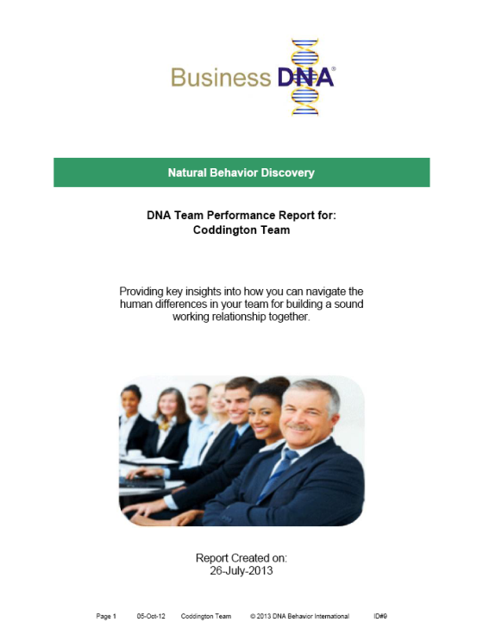
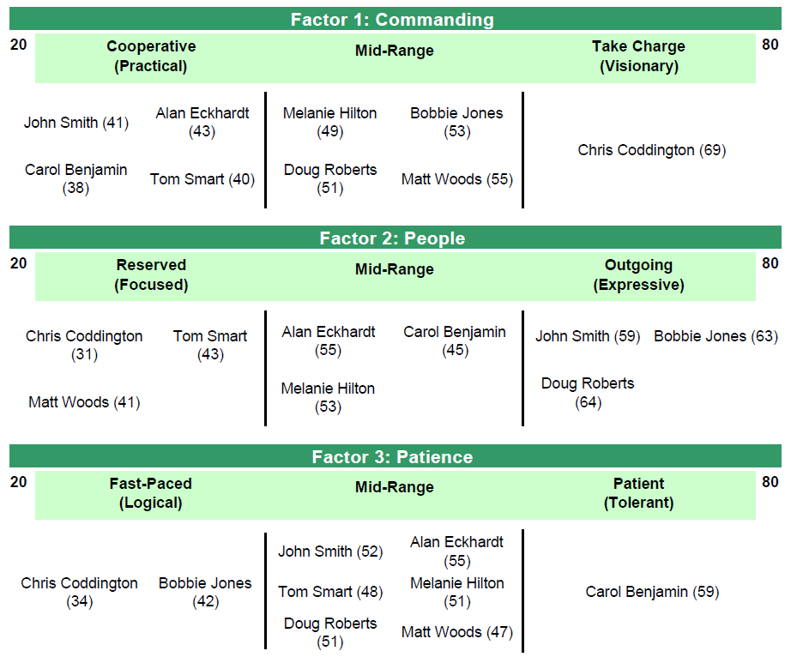
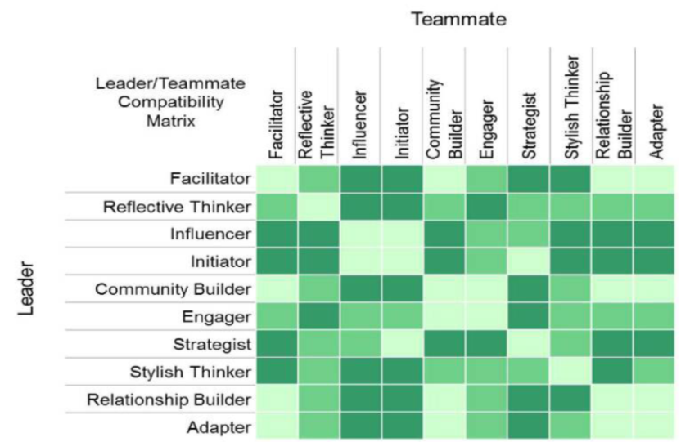

Review Your Business DNA Team Report
Core Work Life Drivers - Natural Behavior Team Report
Natural Behavior Team Report
Leveraging Team Talents for Success
Hiring and Aligning Top Talent
Understanding, Accepting, Respecting Differences for Enhanced Team Work
Team Compatibility Matrix- Natural Behavior Team Report

Slide 25
Team Activity 5: Building Future Team Effectiveness
Using the DNA Ultimate Performance Guide’s
Identify the single most important strength each person brings to the team, starting with yourself.
Identify the one struggle that each teammate should manage for the good of the team, starting with yourself.
Team Member Name | Single Most Important Strength | One Struggle to Manage
1.
2.
3.
4.
5.
6.
7.
8.
9.
10.
11.
12.
13.
14.
15.

Slide 26
Methodology for Reviewing Team Reports
Ideal team size is typically 8 to 10 people
Identify the team’s purpose, business goals and the key processes
Identify the leader and his/her role in the team
Identify the team roles and the talents required to fill them
Identify talent gaps
Identify potential behavioral blockages to success
Identify team stability

Slide 27
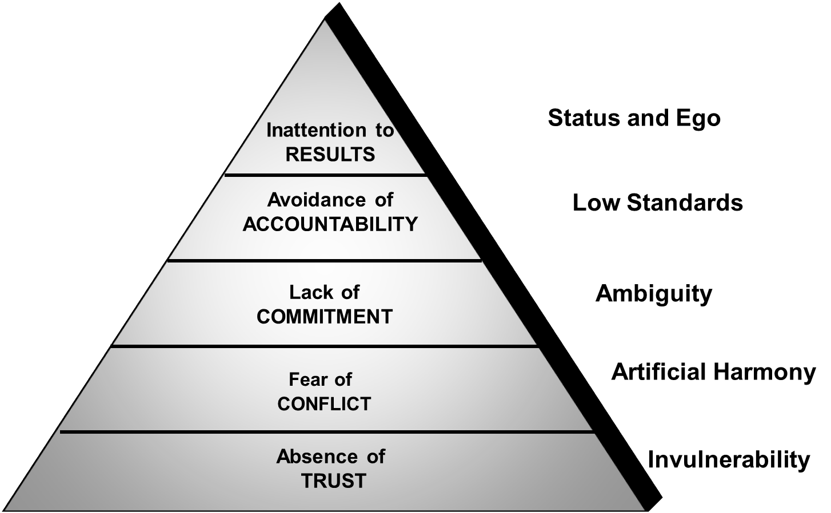
5 Behaviors of Healthy Teams
The 5 Dysfunctions of a Team
Team mates trust each other
Creative conflict is the accepted norm
Commitment to team goals and teammates is evident in actions/behaviors not just words
Team members hold each other accountable
There is a keen focus on team results

Slide 28
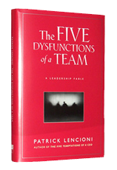
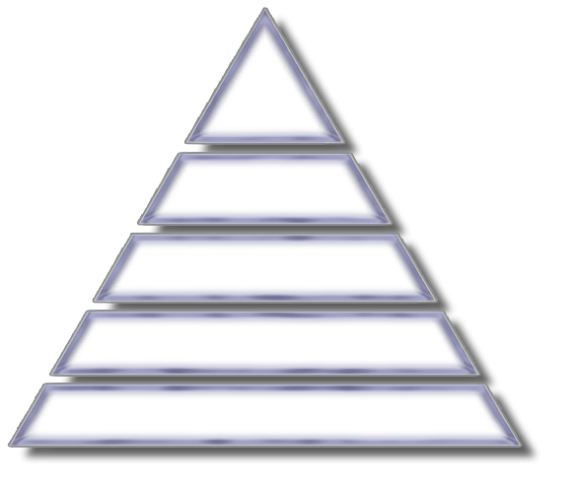

The Five Dysfunctions of a Team
DISCIPLINE 1
The Role of the Leader
Absence of…
Trust
Be Vulnerable

Slide 29
Be Vulnerable
The problem: Absence of Trust
Techniques to build Trust:
Share first job
Share worst job
Share a personal achievement from your life that was/is a special memory for you.
Share a unique challenge of your childhood.
Favourite hobby or sport

Slide 30
The Five Dysfunctions of a Team
DISCIPLINE 2
The Role of the Leader
Fear of…
Conflict
Demand Debate
Absence of…
Trust
Be Vulnerable

Slide 31
Demand Debate
The problem: Fear of conflict
Techniques to promote creative conflict
1. Mining
2. Real time permission

Slide 32
The Five Dysfunctions of a Team
DISCIPLINE 3
The Role of the Leader
Lack of…
Commitment
Force Clarity and Closure
Fear of…
Conflict
Demand Debate
Absence of…
Trust
Be Vulnerable

Slide 33
Force Clarity and Closure
The enemies of Commitment: Consensus and Certainty
Techniques to gain commitment.
  1. Cascading messages
  2. Deadlines
  3. Contingency and worst case scenarios
  4. Low risk exposure therapy

Slide 34
The Five Dysfunctions of a Team
DISCIPLINE 4
The Role of the Leader
Avoidance of…
Accountability
Confront Difficult Issues
Lack of…
Commitment
Force Clarity and Closure
Fear of…
Conflict
Demand Debate
Absence of…
Trust
Be Vulnerable

Slide 35
Confront Difficult Issues
Problems: Lack of accountability
Techniques to gain accountability
Publication of goals and standards
Simple and regular progress reviews
Team rewards

Slide 36
The Five Dysfunctions of a Team
DISCIPLINE 5
The Role of the Leader
Inattention to…
Results
Focus on Collective Outcomes
Avoidance of…
Accountability
Confront Difficult Issues
Lack of…
Commitment
Force Clarity and Closure
Fear of…
Conflict
Demand Debate
Absence of…
Trust
Be Vulnerable

Slide 37
Focus on Collective Outcomes
Problems: Team and individual status
Techniques to emphasize team results
Public declaration of results
Results based rewards

Slide 38
Team Activity 6: Your Greatest Talents for Team Work
Instructions: Assign the team into groups of 2 or more based on their strongest factor on the left or right hand side. Then ask the group to spend 20 minutes preparing a 5 minute presentation on why their talents are the greatest for their role as a team member.
Why are your traits the greatest for being a team member?
What are the key struggles of your greatest traits?
How do you like to be managed?
What one struggle from another (factor) group irritates you the most?

Slide 39
Team Activity 7: Improving My Team Work
Improving My Teamwork (With self-awareness of my strengths and struggles, 5 actions for me to be a better team contributor)
1.
2.
3.
4.
5.

Slide 40
Team Activity 8: Influencing Others in the Team
Influencing Others in the Team (5 actions for me to adopt to demonstrate leadership and enhance my level of influence across the team)
1.
2.
3.
4.
5.

Slide 41
Team Activity 9: 3 Key Changes for Transforming My Team Performance
3 Key Changes for Transforming My Team Performance
Action Step for My Team Performance | Timing / When to Take Action
1. | 1.
2. | 2.
3. | 3.

Slide 42
The 6 Pillars of DNA Team Performance
Process
Team members to prepare Business DNA Comparison Reports to have open communication with other team members about how they can best work with each other.
Optional: Communication DNA
4. Team Relationship Deliverables:
Business DNA Comparison Reports
DNA Ultimate Performance Card
Business DNA Unlocking Human Capital Guide

Slide 43
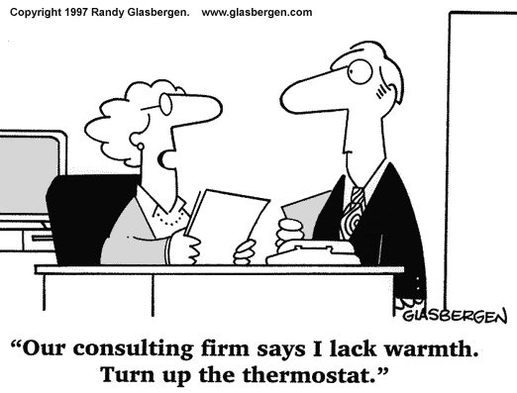
Building Team Relationships
To build a sound relationship you need to:
Follow the Platinum Rule of Relationships: Know how to adapt your communication to be on the other person’s terms. Empathetically demonstrate your understanding of them when communicating.
Be aware of how your strengths and struggles can impact the other person and be prepared to adapt your behavior.
Transparency builds trust. Be able to openly share of yourself to build trust: “knowing me-knowing you”. Openly admit your strengths and struggles.

Slide 44
Team Activity 10 – Building Mutual Relationships
Share with the team – with the leader starting:
3 Unique Strengths
2 Unique Struggles
3 Environment Keys (Communication)

Slide 45
Building Effective Team Communication
Chris Coddington
Doug Roberts
Bobbie Jones
Matt Woods
Melanie Hilton
Tom Smart
Carol Benjamin
Alan Eckhardt
John Smith
Chris Coddington Business Leader (Strategist)
John Smith COO (Stylish Thinker)
Behavior Very Alike – Minimal Modification Required
Alan Eckhardt Client Relationship Mgr (Community Builder)
Carol Benjamin Financial Planner (Relationship Builder)
Some Traits the Same, Some Different – Some Modification Required
Tom Smart Analyst (Reflective Thinker)
Melanie Hilton Family Facilitator/Trainer (Facilitator)
Behaviorally Opposite – Significant Modification Required
Bobbie Jones Sales Leader (Influencer)
Doug Roberts Client Seminars (Engager)
Matt Woods Investment Manager ( Strategist)
Notes:
This graphic is an extract from another tool that we have created to illustrate the differences in a team – the idea is to have plenty of red boxes reflecting there are plenty of differences in the team – you do not want a team full of green boxes because that means similar people have been hired. Again the trick is to use Business DNA to ensure the talents required for a role are matched to the person hired.
And, you don’t want to struggle with communication styles or things won’t get done right the first time.
You also don’t want a team with “discord”
Poor communication is a BLOCK to EXECUTION
You can view these communication styles on your worksheet.
EXAMPLE:
I worked with a team who had been working together for ten years but were having big problems as the business was growing. When I did the profiles, it turned out they were in the “red zone”. The advisor is an Initiator and the assistant is a Community Builder. Their friction centered around his fast paced, task orientation and her need to talk more about the details. He felt she was “holding him back” when in reality she needed more information. Slowing him down, a “wet blanket” on new ideas! I worked with them to help them see how to capitalize on each other strengths and minor adjustments on how to communicate more effectively.

Slide 46
Team Activity 11: Working With Different Talents
Strengths of My Opposite Natural Behavior Style (5 Strengths of my Opposite’s Natural Behavior Style that I do not have)
1.
2.
3.
4.
5.
Notes:
46

Slide 47
Team Activity 12: Working With Different Talents
Struggles of My Opposite Natural Behavior Style (5 actions for me to adopt to demonstrate leadership and be highly effective when working with people with these talents)
1.
2.
3.
4.
5.
Notes:
47

Slide 48
Team Activity 13: Working With Different Talents
Adapting How I Operate to Honor My Opposite Natural Behavior Style (3 actions for me to adapt my behavioral style to help my opposite perform at their best)
Adapting My Natural Approach | Adapting My Communication
1. | 1.
2. | 2.
3. | 3.
Notes:
48

Slide 49
The 6 Pillars of DNA Team Performance
Process:
The Leader to complete the Leadership Performance 360 Discovery Process and have 5 to 10 raters also assess his/her leadership. Create a Leadership Performance Plan based on top 10 leadership strengths and 10 struggle areas.
5. Leader Coaching Deliverables:
DNA Leadership Performance 360 Discovery
DNA Leadership Performance Report and Plan
Powerful Questions for Leaders

Slide 50
The 6 Pillars of DNA Team Performance
Process:
Arrange a quarterly team meeting to address team goals, team interactions, execution blockages, new hires.
DNA Team Performance 360 Discovery Process to be completed for feedback on team and business performance.
6. Team Monitoring Deliverables:
DNA Team Performance 360 Discovery
DNA Team Performance Report

Slide 51
Team Sustainability Programs
Once the behavioral awareness is developed in the team we have additional specialized programs in the following areas:
  Team dysfunctions and Trust
  Business planning
  Communication training
  Effective meetings
  Conflict resolution
  Communication training

Slide 52
Case Study 5: Coddington Financial Services Team
Objective: Building the team for business expansion
The current team:
Chris Coddington – Advisor and Leader
John Smith – Chief Operating Officer
SCENARIO – Initial business success –
now hiring the team for the long term
Based on behavior, what type of people does
this team need?

Slide 53
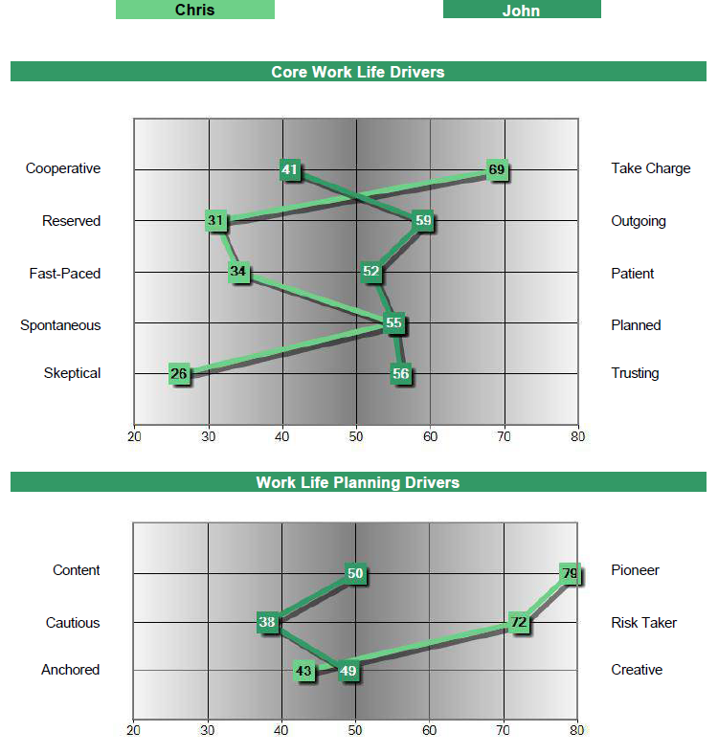
Chris Coddington & John Smith Comparison Graph
Strategist
Stylish Thinker

Slide 54
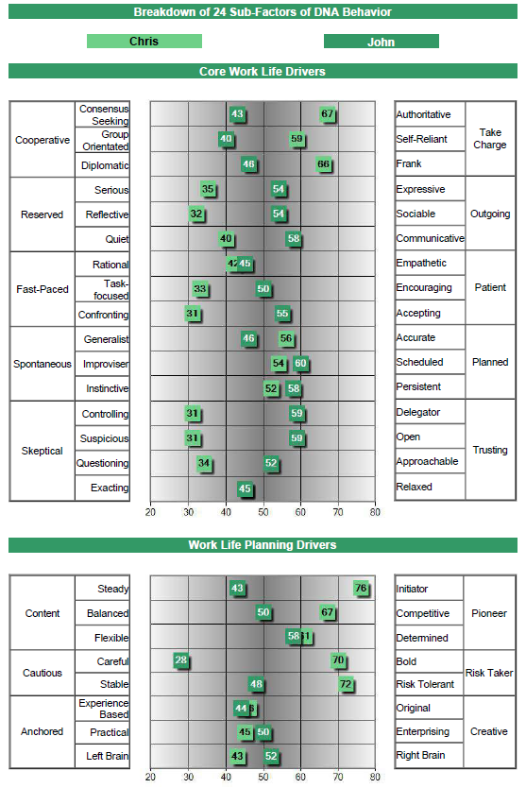
Chris Coddington & John Smith Comparison Sub-factors

Slide 55
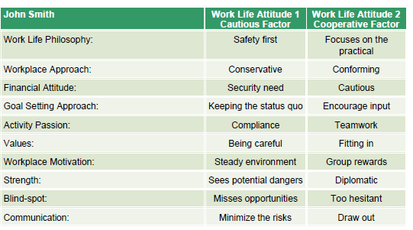
Chris & John Work Life Attitudes

Slide 56
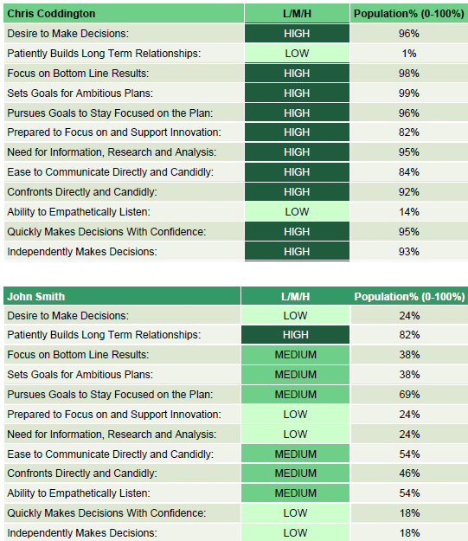
Workplace Insights

Slide 57
Coddington Financial Services Team
Positions To Be Hired:
Alan Eckhardt – Client Relationship Manager
Tom Smart - Analyst
Carol Benjamin – Financial Planner
Melanie Hilton – Trainer and Family Facilitator
What Natural Behavior Style would you expect each to have?
Insert their names on the following 2 pages.

Slide 58
Natural Behavior Discovery Team Matrix
Cooperative
Mid-Range
Take Charge
John Smith
Chris Coddington
Reserved
Mid-Range
Outgoing
Chris Coddington
John Smith
Fast Paced
Mid-Range
Patient
Chris Coddington
John Smith
Spontaneous
Mid-Range
Planned
Chris Coddington
John Smith
Skeptical
Mid-Range
Trusting
Chris Coddington
John Smith

Slide 59
Natural Behavior Discovery Team Matrix
Content
Mid-Range
Pioneer
John Smith
Chris Coddington
Cautious
Mid-Range
Risk Taker
John Smith
Chris Coddington
Anchored
Mid-Range
Creative
Chris Coddington
John Smith

Slide 60
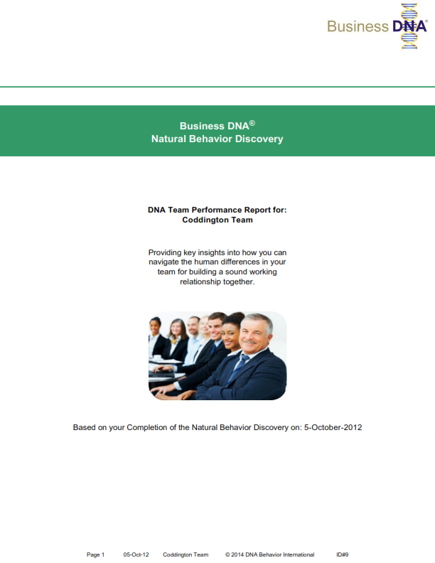
DNA Team Performance Report: Coddington Team

Slide 61
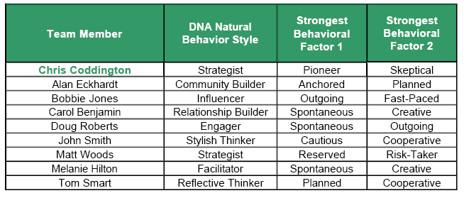
DNA Natural Behavior Style – Coddington Team

Slide 62
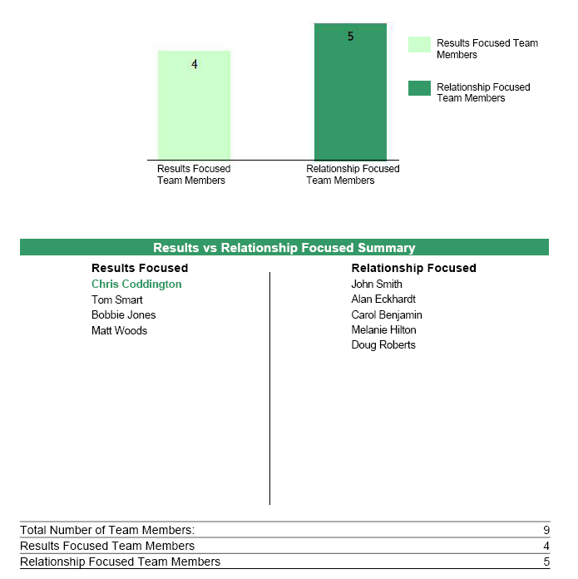
Results Focused vs. Relationship Focused

Slide 63
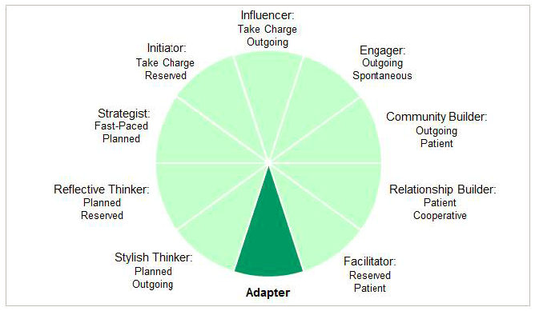
Summary of DNA Natural Behavior – The 10 Unique Styles

Slide 64
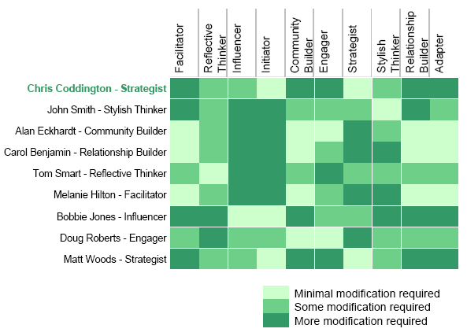
Team Compatibility Matrix

Slide 65
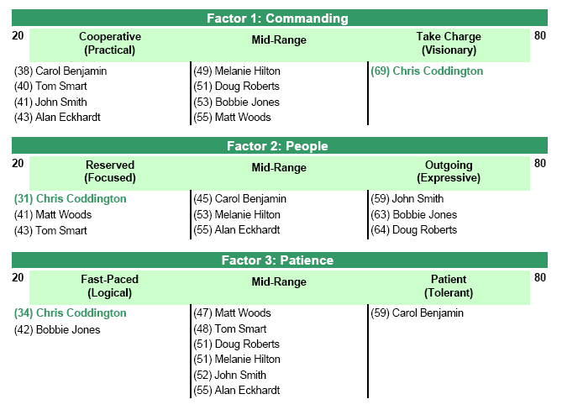
Core Work Life Drivers – Coddington Team

Slide 66
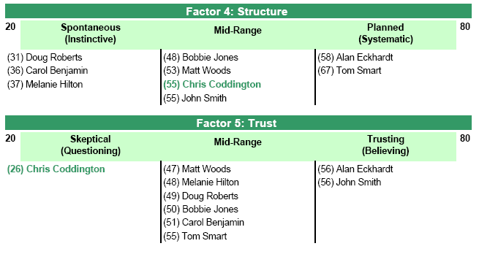
Core Work Life Drivers (Continued) – Coddington Team

Slide 67
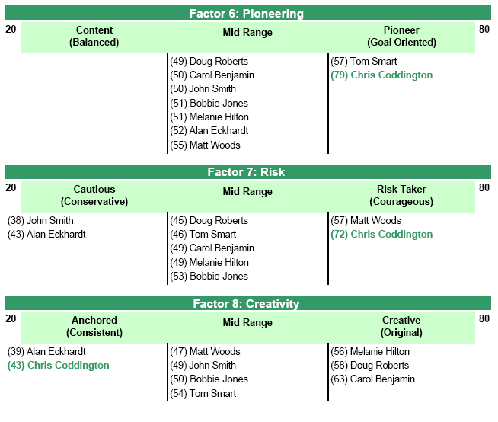
Work Life Planning Drivers – Coddington Team

Slide 68
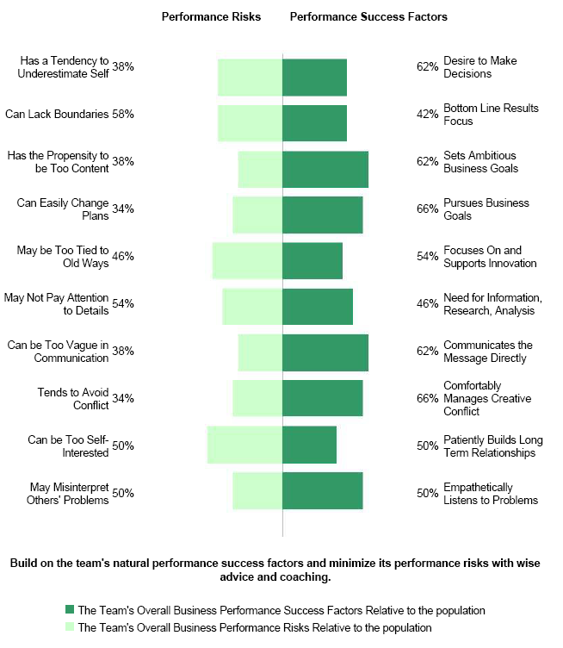
Team’s Overall Business Performance Risks and Success Factors

Slide 69
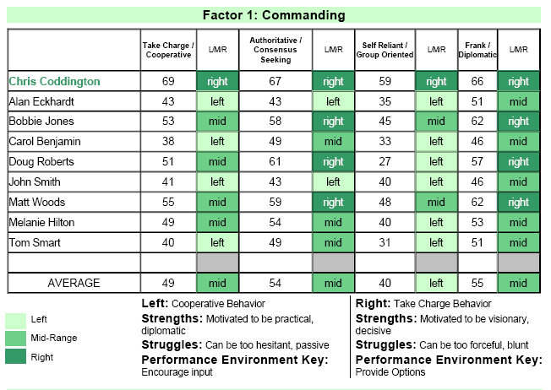
Natural Behavior Scores – Coddington Team

Slide 70
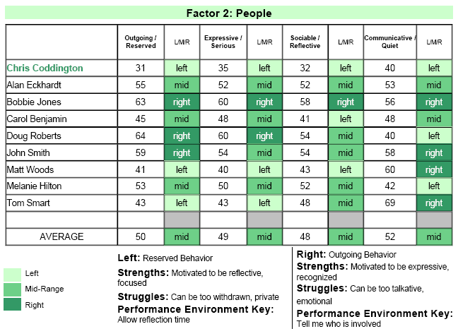
Natural Behavior Scores – Coddington Team

Slide 71
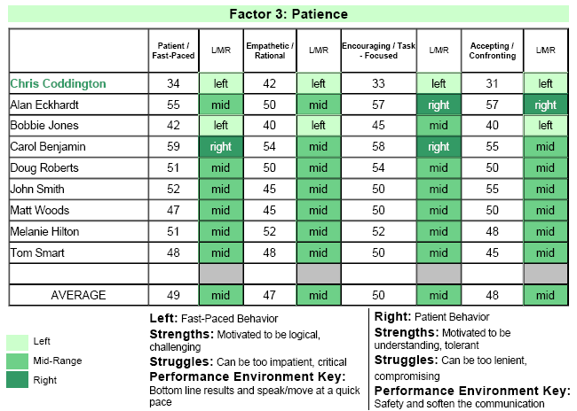
Natural Behavior Scores – Coddington Team

Slide 72
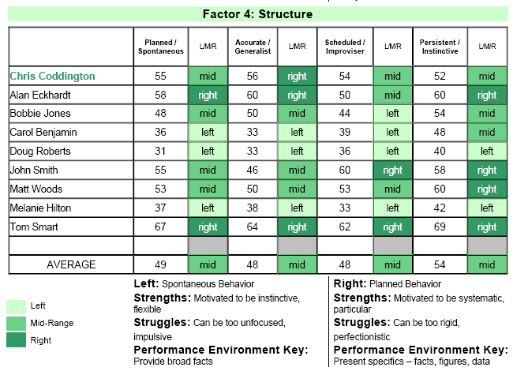
Natural Behavior Scores – Coddington Team

Slide 73
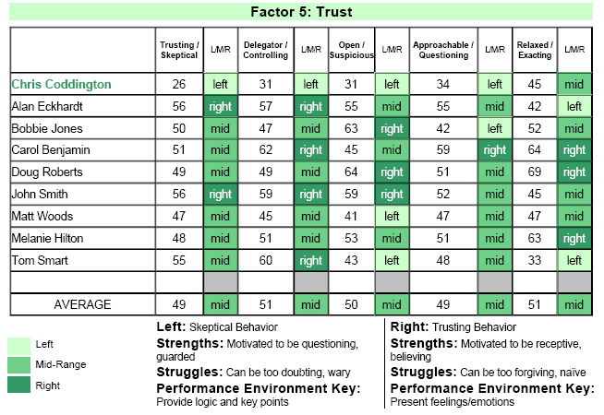
Natural Behavior Scores – Coddington Team

Slide 74
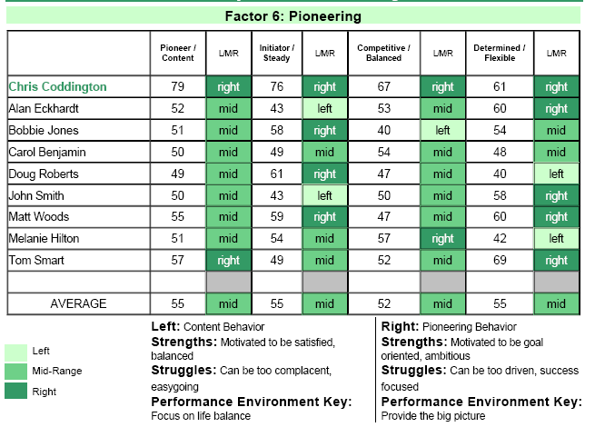
Natural Behavior Scores – Coddington Team

Slide 75
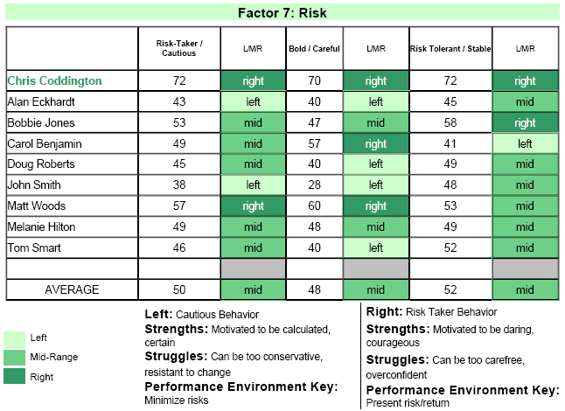
Natural Behavior Scores – Coddington Team

Slide 76
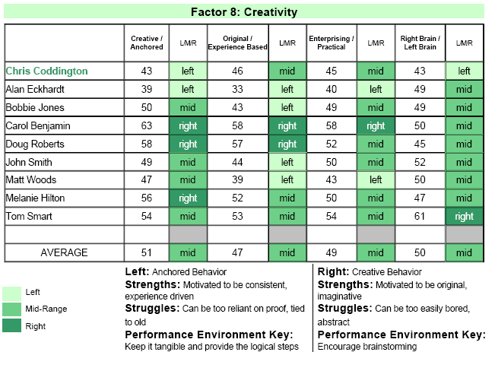
Natural Behavior Scores – Coddington Team

Slide 77
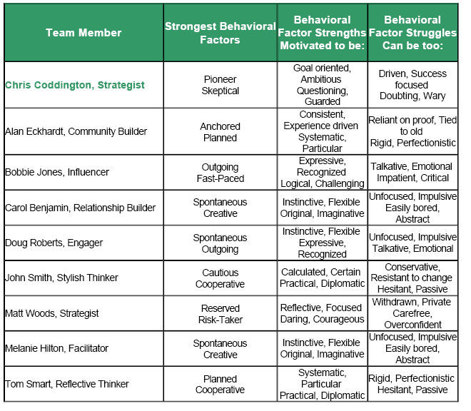
Summary of Team Member Behavioral Strengths and Struggles

Slide 78
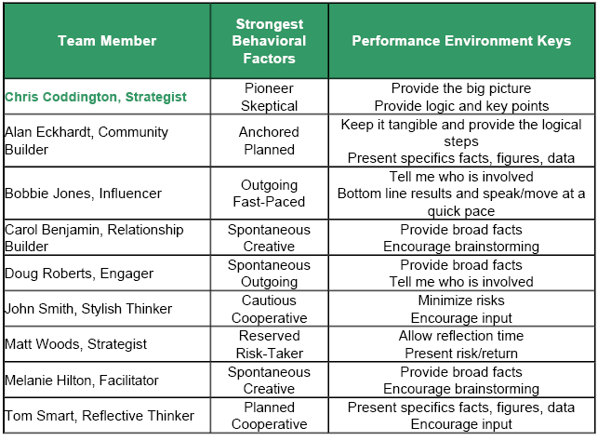
Summary of Team Member Behavioral Performance Environment Keys

Slide 79
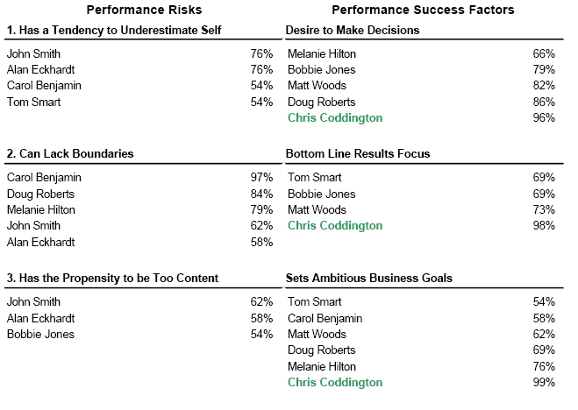
Analysis of Team Member Business Performance Success Factors and Risks

Slide 80
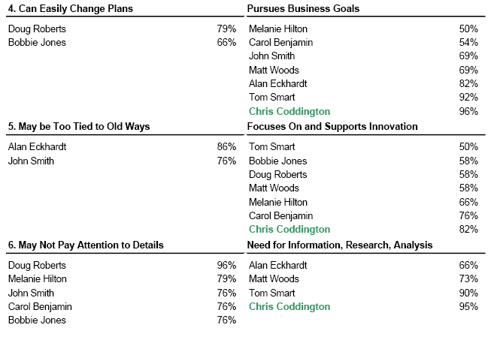
Analysis of Team Member Business Performance Success Factors
and Risks

Slide 81
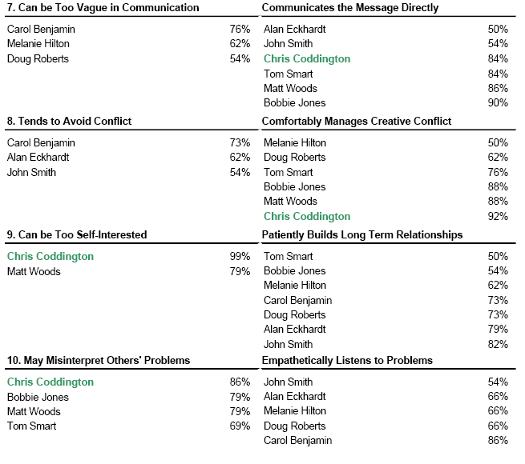
Analysis of Team Member Business Performance Success Factors
and Risks

Slide 82

DNA Team Performance Report: Jensen Team

Slide 83
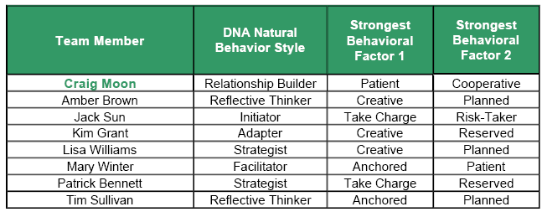
DNA Natural Behavior Style – Jensen Team

Slide 84
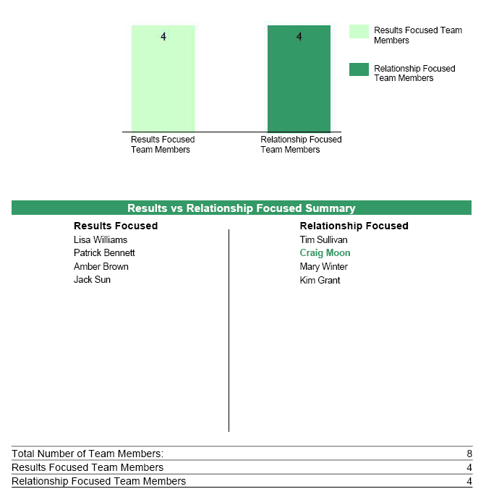
Results Focused vs. Relationship Focused

Slide 85
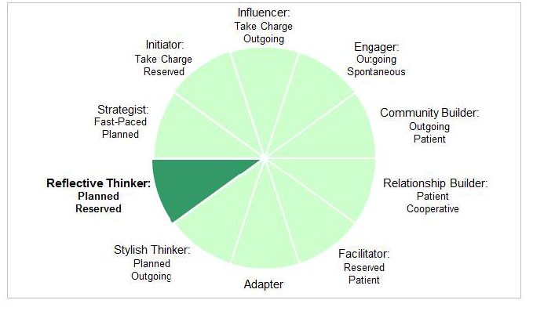
Summary of DNA Natural Behavior – The 10 Unique Styles

Slide 86
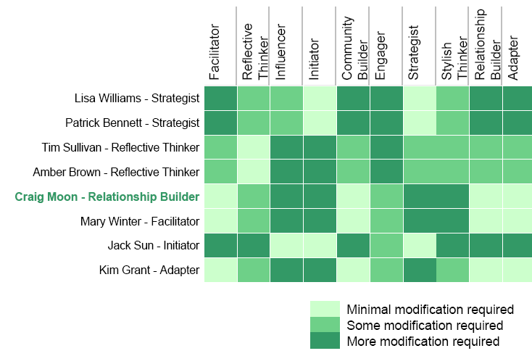
Team Compatibility Matrix

Slide 87
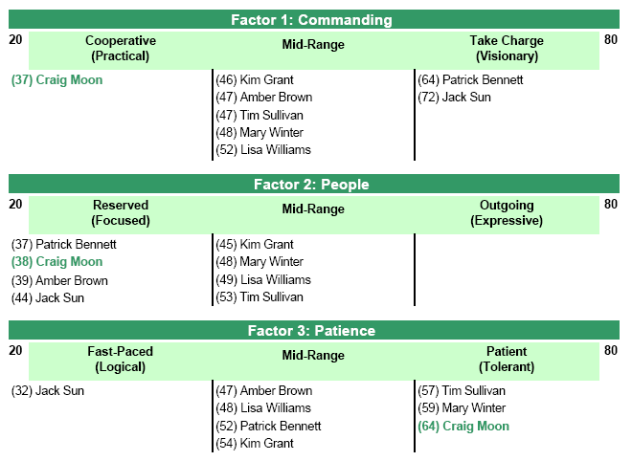
Core Work Life Drivers (Continued) – Jensen Team

Slide 88
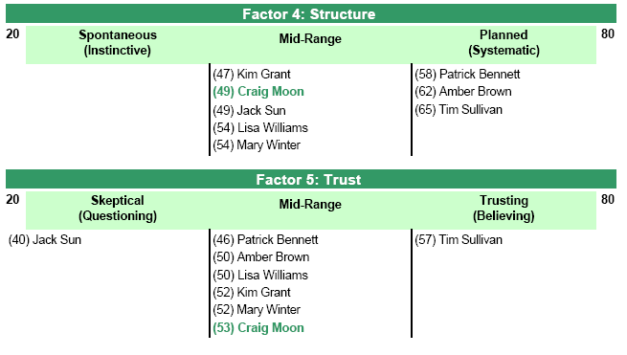
Core Work Life Drivers (Continued) – Jensen Team

Slide 89
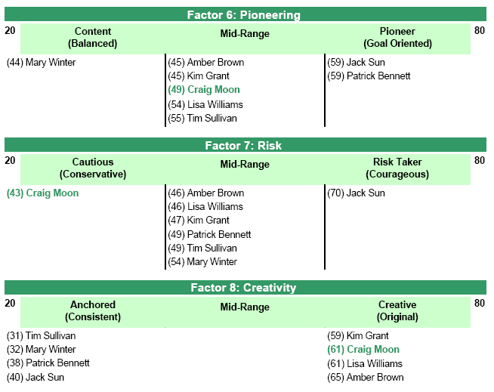
Work Life Planning Drivers (Continued) – Jensen Team

Slide 90
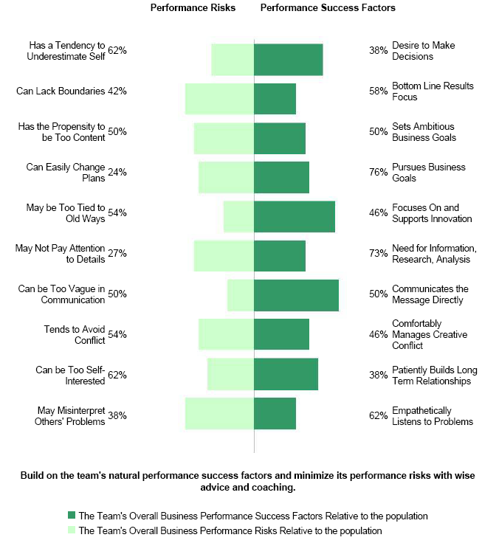
Team’s Overall Business Performance Risks and Success Factors

Slide 91

Natural Behavior Scores – Jensen Team

Slide 92

Natural Behavior Scores – Jensen Team

Slide 93

Natural Behavior Scores – Jensen Team

Slide 94

Natural Behavior Scores – Jensen Team

Slide 95

Natural Behavior Scores – Jensen Team

Slide 96

Natural Behavior Scores – Jensen Team

Slide 97

Natural Behavior Scores – Jensen Team

Slide 98

Natural Behavior Scores – Jensen Team

Slide 99

Summary of Team Member Behavioral Strengths and Struggles

Slide 100

Summary of Team Member Behavioral Performance Environment Keys

Slide 101

Analysis of Team Member Business Performance Success Factors and Risks

Slide 102

Analysis of Team Member Business Performance Success Factors
and Risks

Slide 103

Analysis of Team Member Business Performance Success Factors
and Risks

Slide 104

DNA Team Performance Report: Raddison Team

Slide 105

DNA Team Performance Report: Raddison Team

Slide 106

Results Focused vs. Relationship Focused

Slide 107

Summary of DNA Natural Behavior – The 10 Unique Styles

Slide 108

Team Compatibility Matrix

Slide 109

Core Work Life Drivers (Continued) – Raddison Team

Slide 110

Core Work Life Drivers (Continued) – Raddison Team

Slide 111

Work Life Planning Drivers (Continued) – Raddison Team

Slide 112

Team’s Overall Business Performance Risks and Success Factors

Slide 113

Natural Behavior Scores – Raddison Team

Slide 114

Natural Behavior Scores – Raddison Team

Slide 115

Natural Behavior Scores – Raddison Team

Slide 116

Natural Behavior Scores – Raddison Team

Slide 117

Natural Behavior Scores – Raddison Team

Slide 118

Natural Behavior Scores – Raddison Team

Slide 119

Natural Behavior Scores – Raddison Team

Slide 120

Natural Behavior Scores – Raddison Team

Slide 121

Summary of Team Member Behavioral Strengths and Struggles

Slide 122

Summary of Team Member Behavioral Performance Environment Keys

Slide 123

Analysis of Team Member Business Performance Success Factors and Risks

Slide 124

Analysis of Team Member Business Performance Success Factors
and Risks

Slide 125

Analysis of Team Member Business Performance Success Factors
and Risks

Slide 126
Business DNA Resources
Email: inquiries@dnabehavior.com
www.businessdna.com

