Slide 2
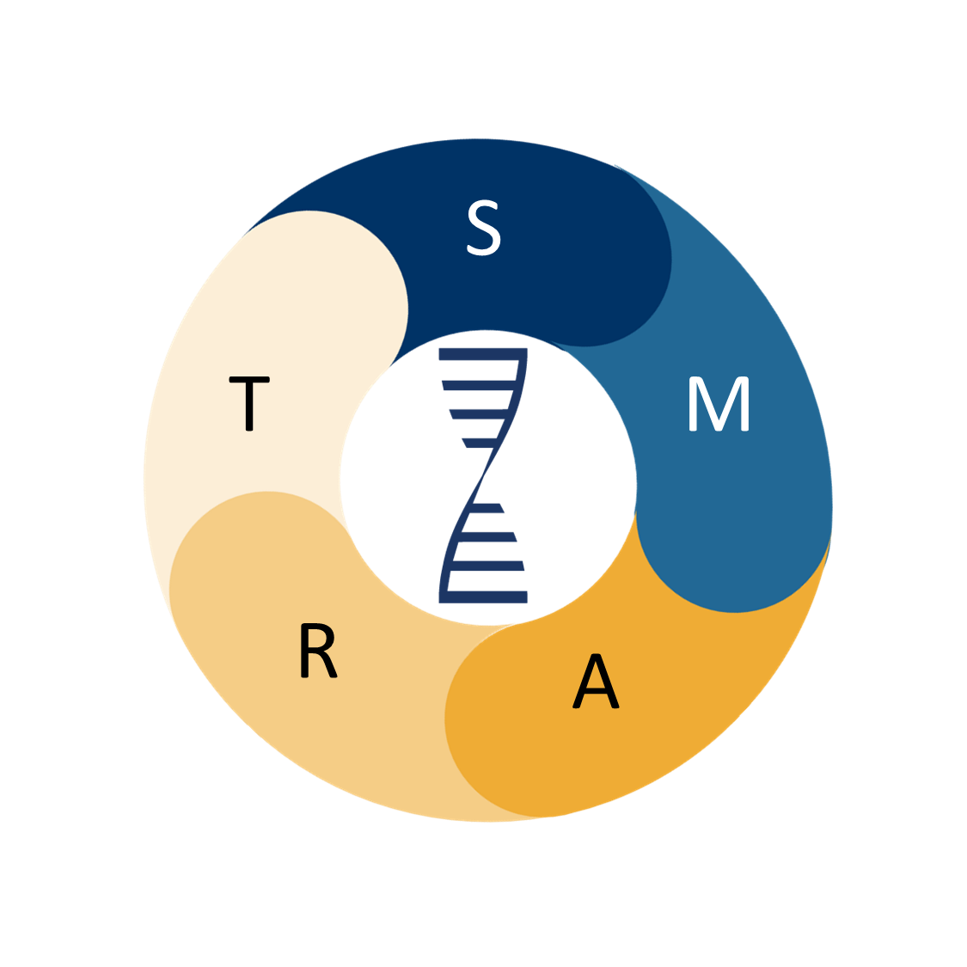
Welcome to DNA Behavior
Use the START SMART process to get going
As you get started with DNA Behavior, you will want to be sure you START SMART – follow the steps in the next two slides to get started on your Behaviorally SMART journey using DNA insights.
The START process helps you ensure you have taken steps to get you started on the path to becoming an expert with our tools.
The SMART model helps you create great client experiences and conversation each time you work with a client. Use the SMART model for all your client conversations.

Slide 3
Set up your admin system by uploading your logo for co-branding
S
Tailor your Financial DNA discovery invitations
T
Five Steps to Successful Onboarding
With DNA Behavior
Ask 5 friends and family members to complete the discovery
A
Review results of friends and family to start to connect DNA insights with how people behave in real life
R
Talk to our trainer to get any questions answered as you start using DNA with your clients
T

Slide 4
Style Review of Self and Client
Modify to Match Client
Ask Client About Their DNA
Behaviorally Smart Meetings Power your meetings with Financial DNA by connecting Science, Methodology, and ART.
Review DNA Results
Talk About Next Steps

