Slide 1

One-Minute Brain Break: Standing Knee Raise

Slide 2
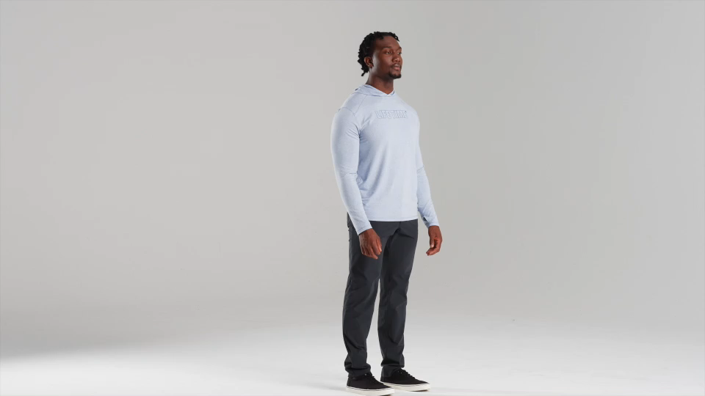
One-Minute Brain Break: Bob and Weave

Slide 3
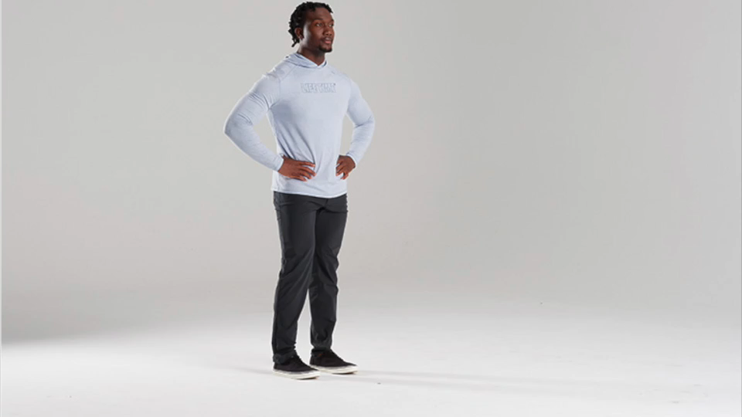
One-Minute Brain Break: Alternating Lunge

Slide 4
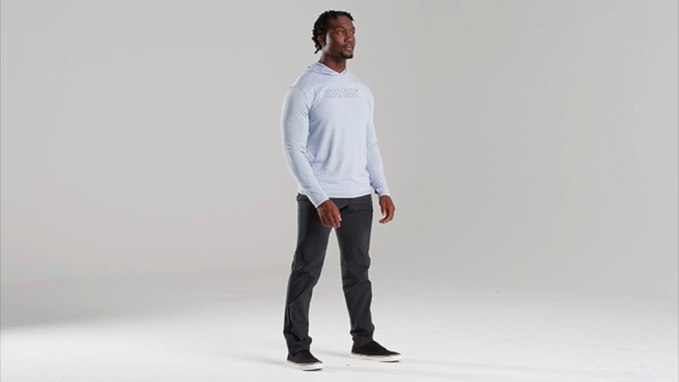
One-Minute Brain Break: Squat Jump

Slide 5
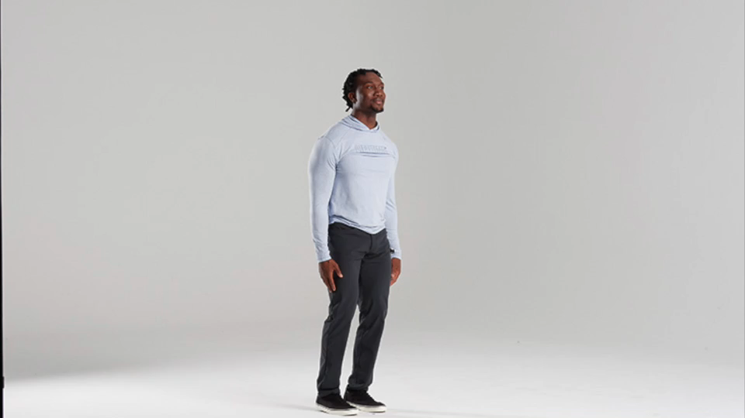
One-Minute Brain Break: Jumping Jack

