Slide 1
DNA® Behaviorally Smart Hiring Process
Building a Behavioral Process to Recruit the Right Candidates

Slide 2
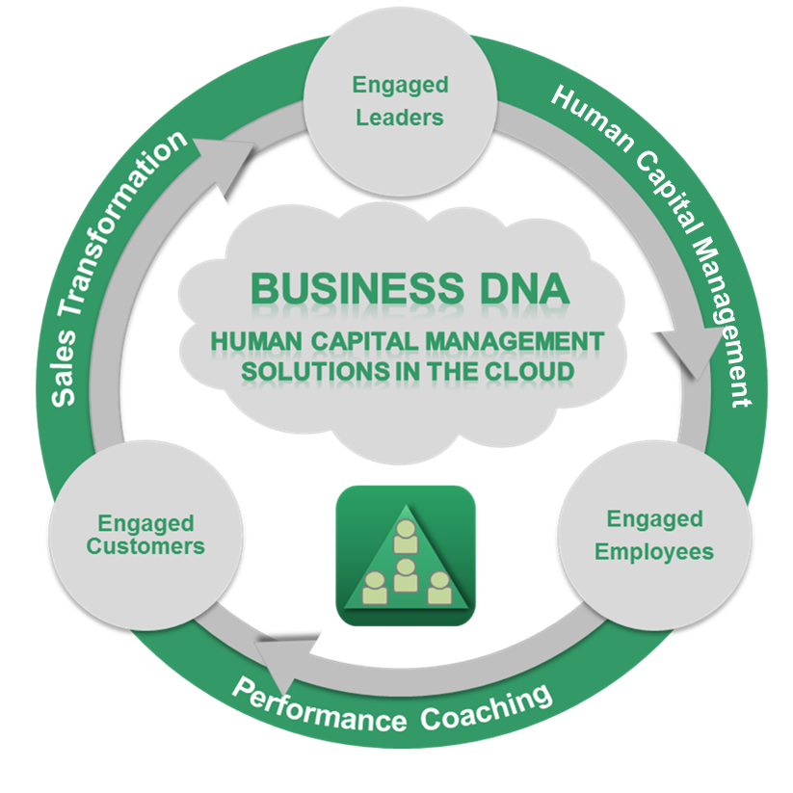
Business DNA® Delivering Talent Management Data Behavioralizing Hiring and Team Development
Know, Engage and Grow Every Employee using our Behavioral Technology Platform.
Since 2001, we have been delivering unique talent management data for leaders, employees and consultants to be Behaviorally SMART™ so they can build, coach and mentor their teams to achieve greater productivity and increased self-empowerment.
Talent management data for matching talents, role and teams is a proven way to build a high performance business.

Slide 3
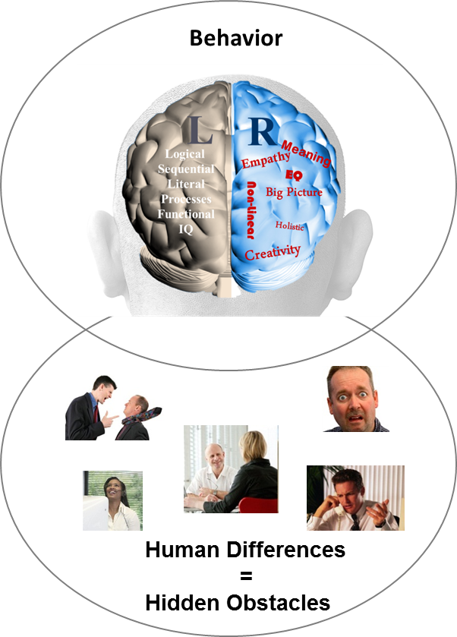
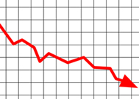
The Need to Reveal and Manage Hidden Team Talent Differences
Behavior Causes Business Performance Challenges for Accounting Firms
Recruiting Talent
?
Employee Retention& Productivity
?
Sales, Client Relationship, Operational Execution
?
Leadership Style
?
87% of
measurable business issues are behavior and communication related
Business
Performance
Source: Harvard Business Review 2002

Slide 4

Hiring
Performance Challenges
Hiring “Round Pegs in Round Holes”
Building a recruitment process that leads to ongoing employee engagement
Matching the natural talents needed for a role
Fit of the candidate into the overall team
Relationship of the candidate to his/her manager
Getting below the surface in the interview to identify the true behaviors, passions, values, purpose, money
Successful performance in a different operating environment not translating to productivity
High cost of a bad hire

Slide 5
Talent Management Challenge
Building a Hiring and On-boarding Experience to Build Engagement and Reduce Turnover
Better Knowing the Behavioral Style of Team Members and Recruits
Improving Hiring and On-Boarding by Matching Talents to Roles and Teams, building a role benchmark
Keeping Leaders Engaged to Grow Future Leaders and Talent Pipeline

Slide 6
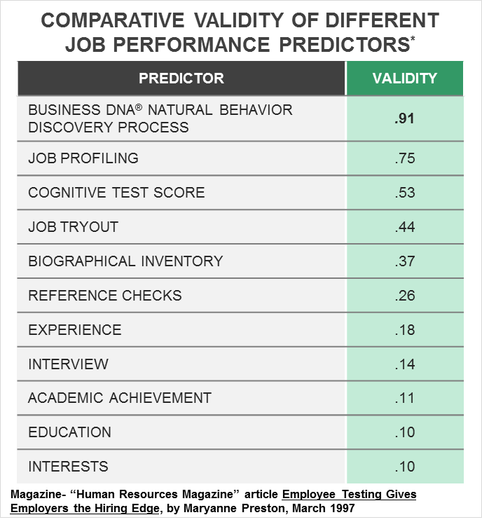
Business DNA as the Foundation of a
Robust Behavioral Hiring Process
Aptitude and Personality Assessments
Increase accuracy of a successful hire to 53%
Job Profiling
75% Accurate
Interview process alone
only 14% accurate
Studies by John Hunter, Ph.D., Michigan State University

Slide 7
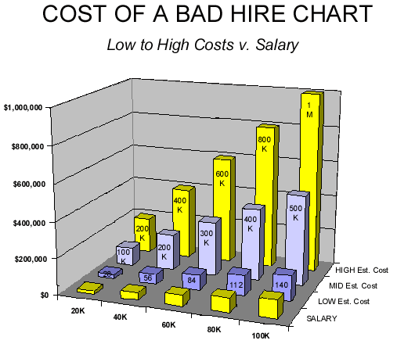
Cost of Bad Hires Multiples of Salary
The cost of a bad hire is estimated to be in the following multiples of salary due to lost productivity, re-training, re-hiring expenses:

Slide 8
Business DNA Hiring Performance Handbook
Specific Steps for a Robust Hiring Process

Slide 9
DNA Hiring Performance Process
Critical Success for Hiring the Right Candidates
1. Build a Positive Hiring Culture based on a defined belief system and clear processes
6. Conduct Behavioral Interview using powerful questions based on the strongest behavioral factors
2. Identify
the Role knowing the talents required based on current team member behavioral styles and activities to be performed
5. Match to Manager by comparing the strengths and struggles of the Manager and Candidate
3. Create Role Benchmark by reviewing the behaviors for the role based on successful performers
4. Match Talent to the Role by having the candidate complete their Natural Behavior Discovery before first interview

Slide 10
The Uniqueness of the Business DNA® Solution
Increased Depth, Reliability, Team Onboarding and Ongoing Management Capability

Slide 11
Business DNA® = Predictable Talents for Performance
Multi-Dimensional Talent Discovery
Fit for Role
Behavioral Talents
Fit to Team
Manager EQ
Notes:
This graphic shows how financial personality is at the epicenter of discovery for the financial planning process .
A key area that we emphasize around investment risk is the differentiation between investment risk propensity (bold, taking risks) versus the risk tolerance (loss aversion).
Also, the right framework will enable the advisor to see the impact of their behavior.

Slide 12
The Traditional Personality Profiling Systems
Leave you in the Dark in Critical Areas
Predictable Talents,
Communication Style How to Adapt,
Onboarding
Natural “Hard
Wired”
Behavior
Fit for Role Based on Learned Situational Behaviors
Team Role Gaps, Performance Coaching, Culture,
Leadership

Slide 13
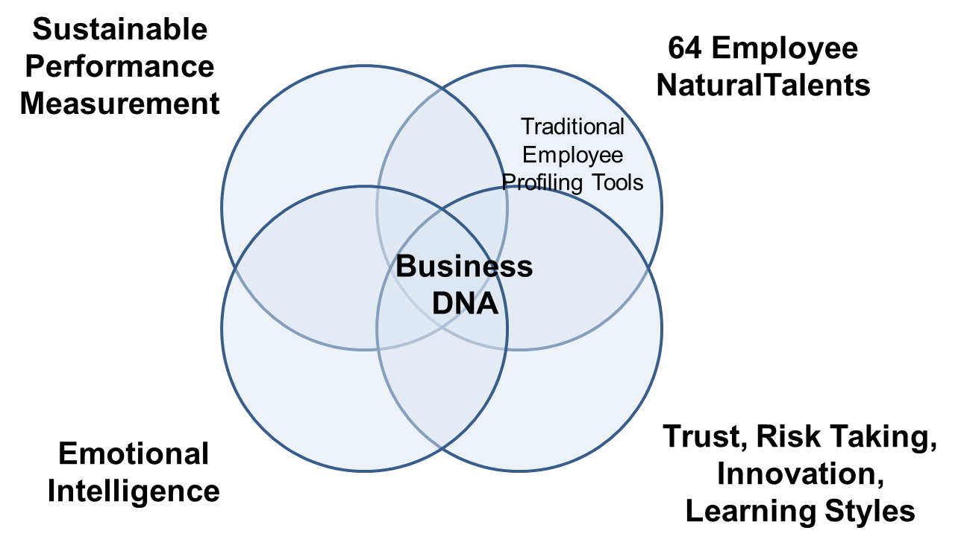
Powerful New and Deeper Behavioral Insights for Hiring and Ongoing Talent Management

Slide 14
Business DNA Talent Management Data
The Science Behind Our Swiss Watch DNA Systems
Powerful and Unique Behaviorally Intelligent Talent Management Solutions Delivered to over 1.5m people in 123+ Countries and 11 Languages
Forced Choice Assessment Measuring 64 Behavioral Traits
60+ Man Years of Development Investment Since 2001
Independent Validation by Team with 100+ Years of Experience

Slide 15

The Definition of Business DNA®
The 2 Levels of a Person’s Workplace Personality
Every person inherently has a unique Business DNA® code representing their workplace (business) personality. The workplace personality influences every life and business decision a person makes (and that of the business they lead or work in), and has 2 levels which are integrated:
1. The natural born DNA behavioral style that remains stable over time and will drive how they consistently respond to different events; and
2. Their current learned behavioral style which is consistently shaped by their environment, life experiences, values and education.

Slide 16

Natural Behavior
Nature or Nurture?
Natural Behavior Make-Up:
Natural behavior is determined by around age 3 when the neural pathways are formed and remains very ingrained. It is based on genetics (“raw material”) and early life experiences.
Nurture - Learned Behavior Make-Up:
People continuously develop although the natural behavior remains the core.
Stronger learned behavior is developed from age 3 to 18 that can be adapted with focus.
Less ingrained learned behavior from age 19 that can be modified with awareness, experiences and education.

Slide 17
Discovering Your Performance Attributes Specifically Identifying Behavioral Talents
LEVEL C
Education, Training, Experience
LEADER- SHIP SKILLS
WORK SKILLS
LEVEL B
COMPETENCIES
Business DNA Natural Behavior
RELATIONSHIPS
RESULTS
NATURAL BEHAVIORAL TALENTS
Heredity and Environment
LEVEL A
CHARACTER and INTEGRITY
Trustworthy * Authentic * Emotionally Stable * Passion, Values,
Purpose Driven

Slide 18
Hiring for Talent
Firstly Identify the Natural Behaviors, and then the Learned Cognitive Factors
BDNA Natural Behavior (Talents)
Learned Behavior and Cognitive Factors
Ideal Role Match

Slide 19
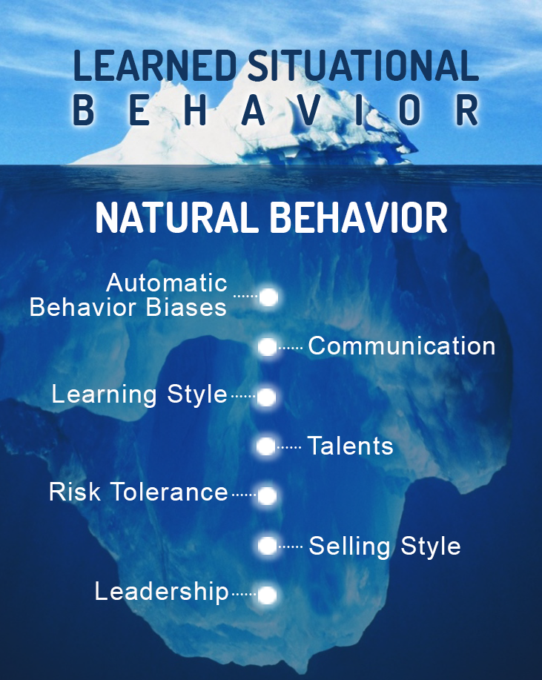
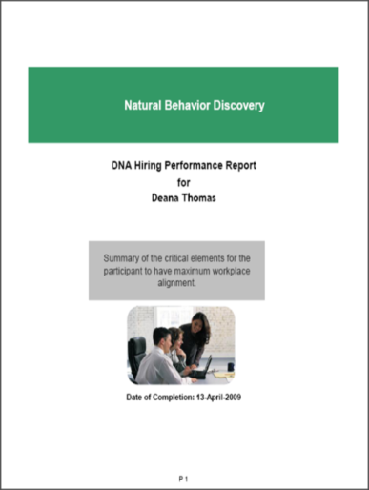
Business DNA is a Quicker and 91% More Reliable Method
Predict How Your Employees and Will React Long-Term
Observations
Do Not Get
Below the
Surface
Business DNA – Natural Talent Discovery and Performance Measurement (10 to 12 mins)

Slide 20
Suite of Business DNA Discovery Processes and Reports on a Single Talent Management Platform
Discovery Process | Business DNA Reporting
DNA Natural Behavioral Talents Discovery: To Predict How an Employee Should Perform and their Automatic Biases Based on Who They Instinctively Are | For revealing different dimensions of an employee’s natural talents for individual and team productivity. Reporting: For all (including the leader) – Summary Report of Strengths and Struggles, Workplace Insights, Recruiting Employees – Hiring Report and 1 Page Factor Reports to identify role fit and build benchmarks for job profiling Onboarding Employees into Teams – Team Report to identify fit with leader/manager and team members Performance Review Meetings with Managers – Comparison Reports of Manager and Employee to build engagement Daily Culture Development - Ultimate Performance Guide (online, office and wallet size)

Slide 21
Business DNA Natural Behavior Discovery
Overview of the Reporting for Hiring by Matching Talents to Specific Roles

Slide 22

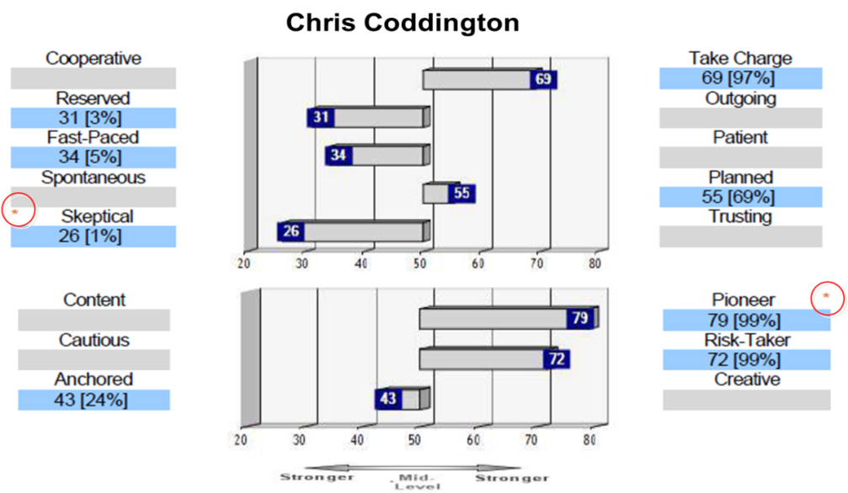
For Hiring and Retaining all Employees Workplace Operations Report for Identifying Talents
Business DNA Workplace Operations Report:
Natural Behavior Style and Factor Reporting
Business Risk Management Factors
Decision-Making Strengths and Struggles
Work Life Attitudes
Work Life Planning Drivers
Business Decision-Making Risk Grouping
Leader-Team Mate Compatibility
Powerful Questions

Slide 23
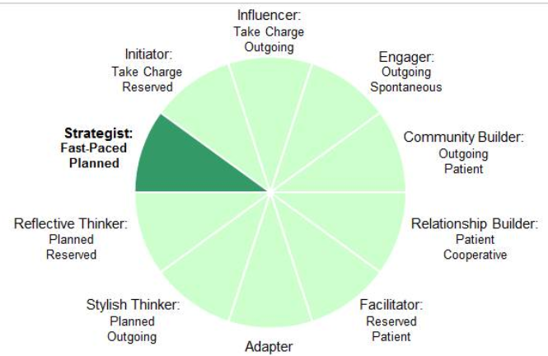
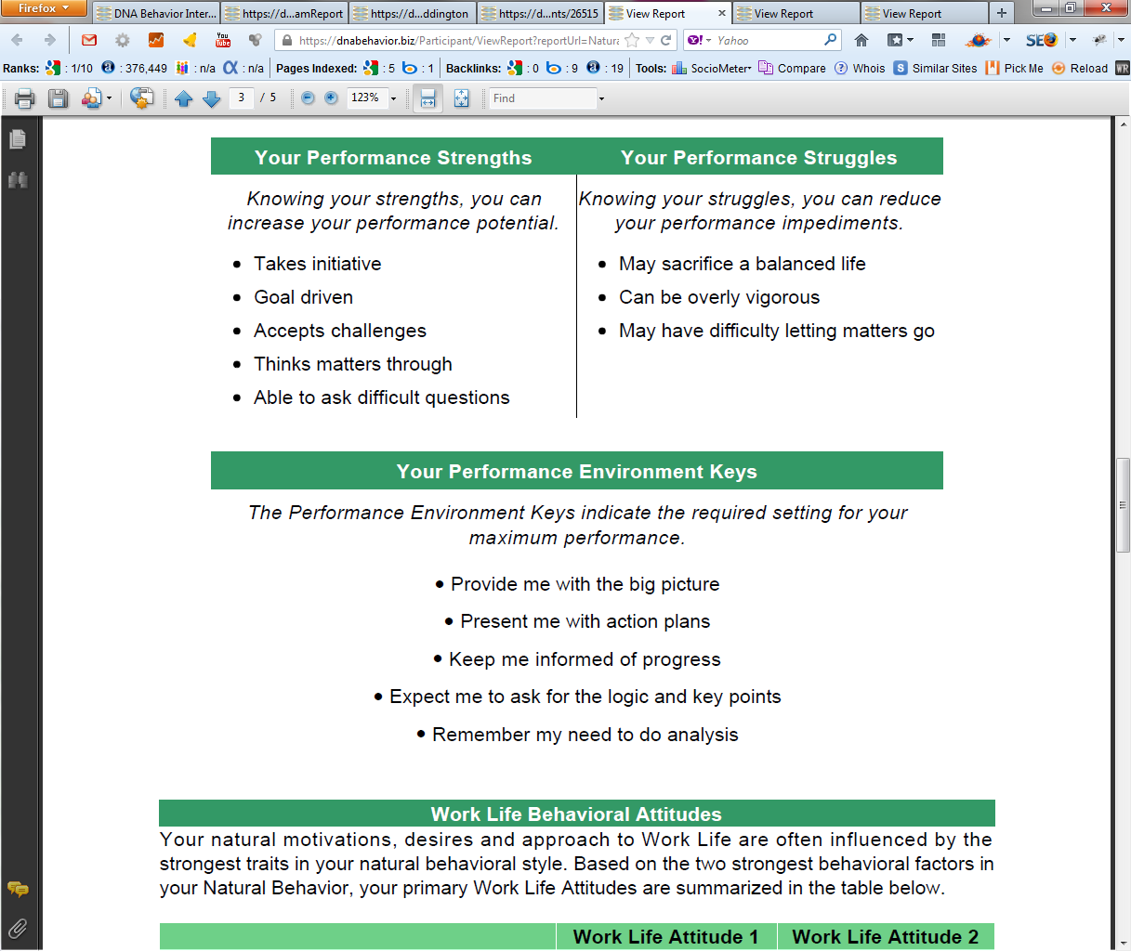
Practical Analysis of the Key Talents that Drive Employee Performance and People Culture
10 Unique Natural Workplace Styles based on 8 Primary Factors and 24 Sub-factors
Customized DNA Ultimate Performance Guide

Slide 24

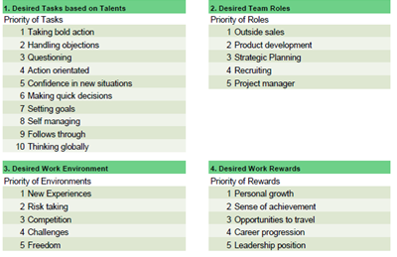
Hiring Based on Matching Talent to Role
Business DNA Hiring Performance Report
Provides insights in priority of importance based on the candidate’s 64 natural behavioral traits measured by the Business DNA Discovery Process (refer 1 Page Factor Report):
10 Desired Tasks
5 Desired Team Roles
5 Desired Work Environment Traits
5 Desired Work Rewards

Slide 25
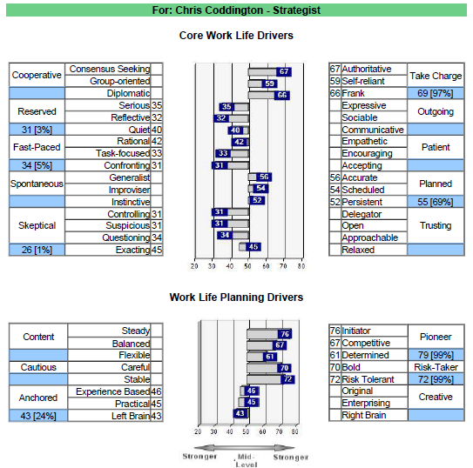
1-Page Factor Report
64 Traits Based on Measuring 8 Factors; 24 Sub-Factors
BDNA 1-Page Factor Report
64 Traits based on measuring the left hand and right side of each of the 8 factors and 24 sub-factors (4 trillion combinations of data).
The sub-factors are one dimension of the primary factor. Each sub-factor is independently measured. They do not average out to the Primary Factor score.

Slide 26
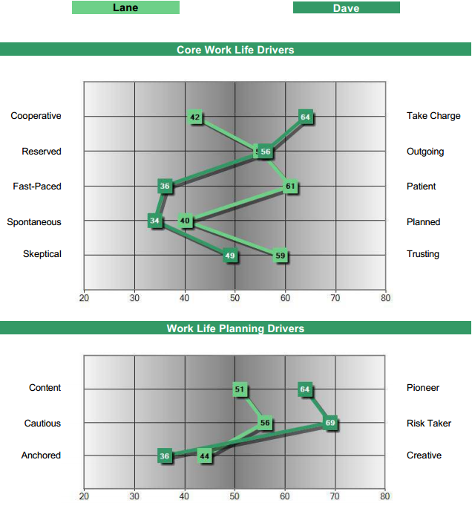
Business DNA Role Benchmark Solution Over 1000 Benchmarks for Hiring Fit to Specific Roles
We have benchmarks:
Standardized for every SOC code
Various professional roles
Customized for specific roles in businesses
Lane: Ideal Style for Relationship Management (“Farming”)
Dave: Ideal Style for New Business Development (“Hunting”)

Slide 27
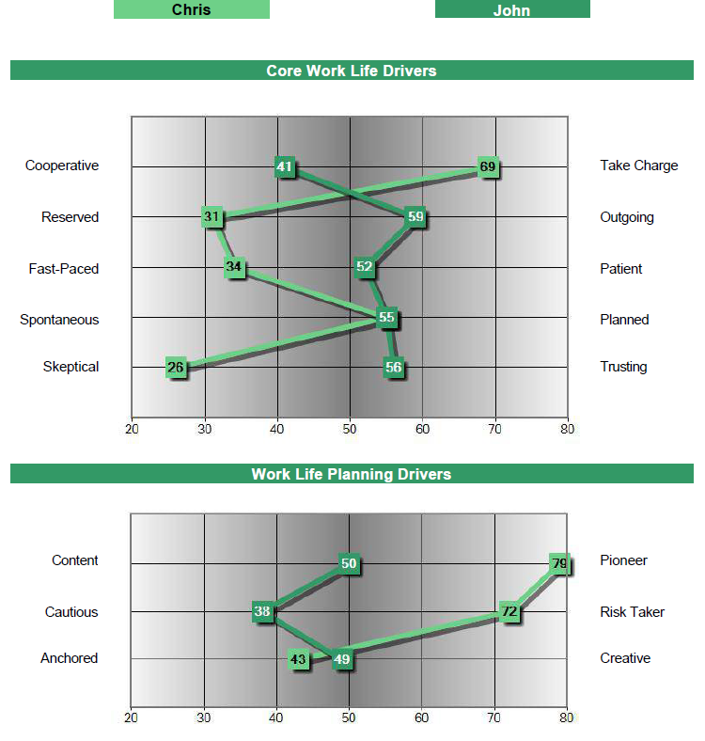
Manager – Employee Onboarding and Performance Review Meetings
Business DNA Comparison Report
Strategist
Stylish Thinker
Identify and navigate
behavioral differences:
Chris may not provide John with the personal engagement he needs
John could be far more content and cautious than Chris’s pushy goal driven style

Slide 28
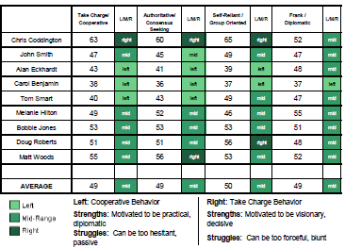
Building a Productive Team
Identifying the Team Gaps Needing to be Filled
The Business DNA Team Report makes understanding who to hire easy by:
Identifying the different talents of team members
Providing graphical analysis of team differences
Summary of Results and Relationship drive differences
Identifies strengths and struggles of team members for role matching
Summary of how to communicate with each team members

Slide 29
Driving Employee Performance and People Culture
DNA Ultimate Performance Guide
Customized DNA Ultimate Performance Guide used online and in paper format for enhancing every human interaction

Slide 30
Behavioral Interviewing
Asking Powerful Questions to Get Further Below the Surface

Slide 31
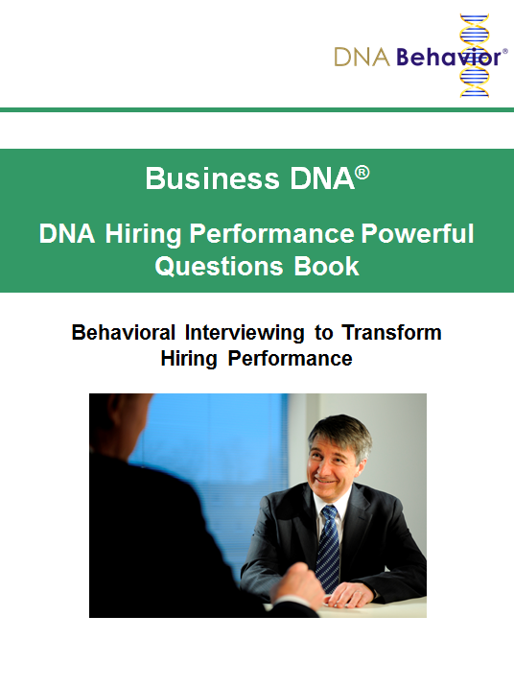
Behavioral Interviewing
Use Powerful Questions Based on the Strongest Factors
The DNA Natural Behavior Unique Style provides a set of behavioral traits which will be generally true for all people in that category. So, not all individuals within the same Natural Behavior Style are exactly the same.
Differences between the same Natural Behavior Styles will be seen in the primary factors and sub-factors. The specific factor and sub-factor scores are critical to determining a match to the role.
Ask interview questions based on the strongest behavioral traits.
Also, the DNA Natural Behavior style is non-biased for gender, race, age and national origin.

Slide 32
Hiring Case Studies for Standard Roles
Using Hiring Insights, Role Requirements and Benchmarks and Interview Issues

Slide 33
Typical Behavioral Characteristics
Standard Benchmarks for Sales Roles
DNA Behavior Factor | Talents - Activity | Outside Sales | Inside Sales | Customer Service
Take Charge | Visionary/Decisive | >55
Cooperative | Listens/Collaborates |  | <50 | <50
Outgoing | Networks/ Communicates | >55 | >55 | >45
Reserved | Task Focused/ Researches
Patient | Friendly/Supportive |  | >45 | >50
Fast Paced | Handles Objections/ Rejection | <45
Planned | Detailed/ Structured |  |  | >50
Spontaneous | Flexible | <45 | <50
Trust | Receptive |  | >50 | >45
Skeptical | Asks Questions | <45
Pioneer | Goal Driven | >55 | >50
Content | Balanced |  |  | <50
Risk Taker | Takes Bold Action | >55 | >45
Cautious | Manages Risk |  |  | <50
Creative | Problem Solves
Anchored | Implements/ Executes | <50 | <50 | <45

Slide 34
Position 1:
Typical Outside Sales Role Requirements
Depending on the business, an outside sales role will generally require the person to be a “rain-maker” (“or Hunter”) focused on generating new business.
The role will include:
Makes quick decisions – realistic approach
Influences opinions- building rapport quickly
Setting goals - directing clients towards goals
Handles objections - calling new prospects
Follows through - accountable for new business targets
Action orientated - having high energy
Comfortable meeting new people - networking
Negotiating - closing capabilities
Confident in new situations – sets up opportunities
Takes bold action – prepared to take risks
Questioning – prepared to ask questions
Working individually – able to operate independently

Slide 35
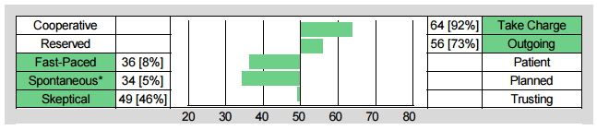
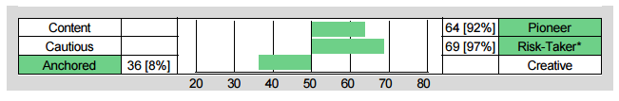
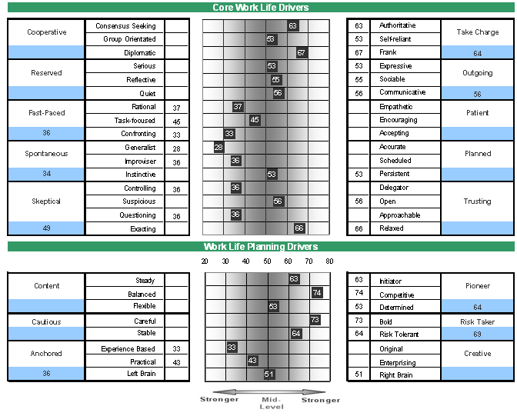
Dave Michaelson –
The Influencer

Slide 36
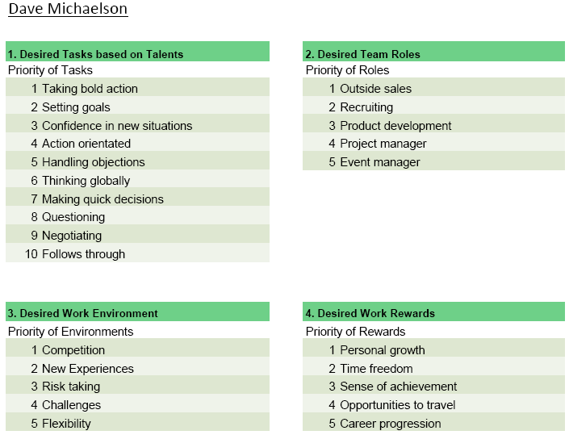
Dave Michaelson –
The Influencer

Slide 37
Issues for Behavioral Interview
Outside Sales Position
Substance over charm
Strategic approach
Does not take no for answer
Persistent and hungry
Builds rapport quickly
Track record in closing sales
Positive attitude toward success
Passion

Slide 38
Position 2:
Typical Inside Sales Role Requirements
Depending on the business, an inside sales role will generally
require the person to be a “farmer” focused on building and
managing existing business/relationships. The role will include:
Being friendly - maintaining relationships
Supportive and patient - responds to client questions
Demonstrates enthusiasm – people connection
Follows through- being reliable to follow up
Listening – empathetic to client needs
Works collaboratively - good team player
Comfortable meeting new people - networking
Negotiating - closing capabilities
Communicating verbally – calling clients

Slide 39
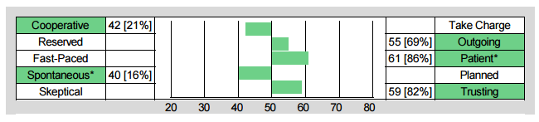
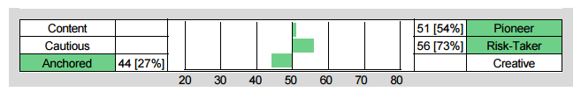
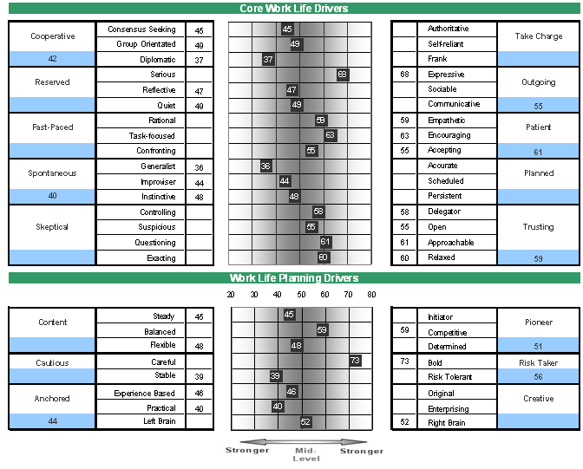
Lane Dixon –
The Community Builder

Slide 40
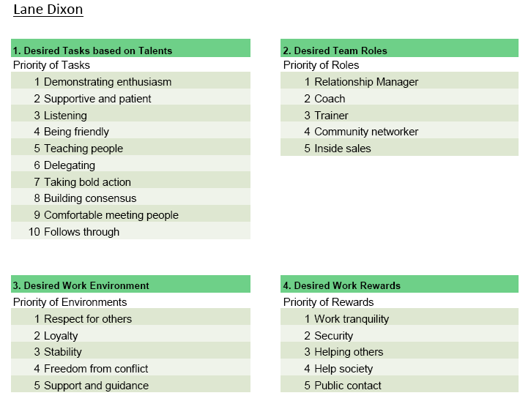
Lane Dixon –
The Community Builder

Slide 41
Issues for Behavioral Interview for an Inside Sales Position
Substance over charm
Good listener
Relational approach
Ability to demonstrate empathy
Reliable
Ability to handle client objections
Track record in closing sales
Positive attitude toward success
Passion

Slide 42
Typical Behavioral Characteristics
Operational Roles
DNA Behavior Factor | Talents - Activity | Operations Manager | Technical Support | Office Administration | Trainer
Take Charge | Visionary/Decisive | >55 |  |  | >45
Cooperative | Listens/Collaborates |  | <50 | <50
Outgoing | Networks/ Communicates | >50 |  |  | >45
Reserved | Task Focused/ Researches |  | <55 | <50
Patient | Friendly/Supportive | >40 | >50 | >50 | >50
Fast Paced | Handles Objections/ Rejection
Planned | Detailed/ Structured | >45 | >50 | >55 | <50
Spontaneous | Flexible
Trust | Receptive | >40 | >45 | >50 | >50
Skeptical | Asks Questions
Pioneer | Goal Driven | >50
Content | Balanced |  | <50 | <50 | <50
Risk Taker | Takes Bold Action
Cautious | Manages Risk | <55 | <50 | <50 | <50
Creative | Problem Solves |  |  |  | >45
Anchored | Implements/ Executes | <50 | <50 | <45

Slide 43
Position 3:
Typical Technical Support Role Requirements
Depending on the business, a technical support role will generally require the person to play a more supportive role inside the business. The role will include:
Executing projects - implementation
Managing time - completing projects on a timely basis
Being collaborative - good team work
Risk management – compliance
Listening – provides support to client and team needs
Supportive and patient - responds to client queries
Being friendly - helping to maintain relationships
Follows procedures - manages technical and back office functions

Slide 44
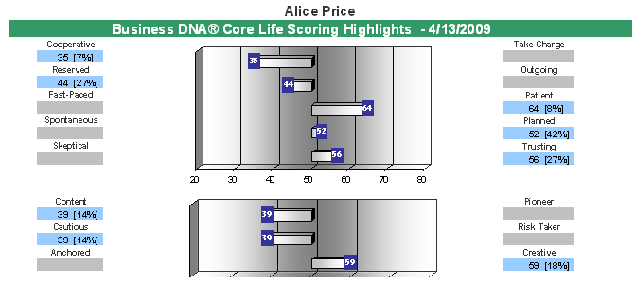
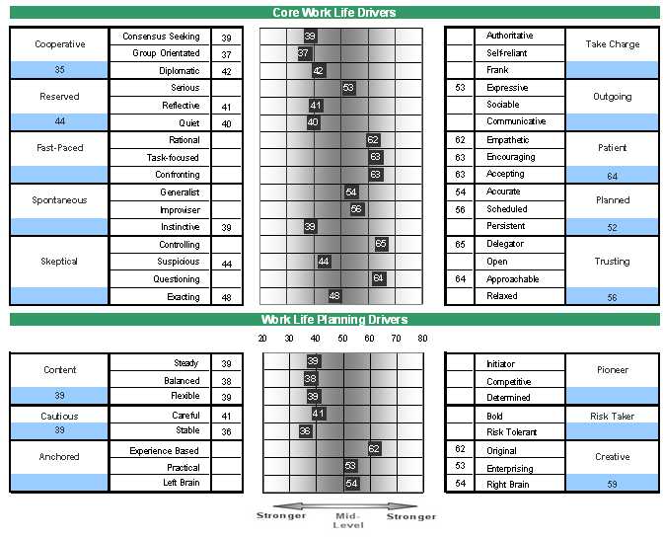
Alice Price
The Relationship Builder

Slide 45
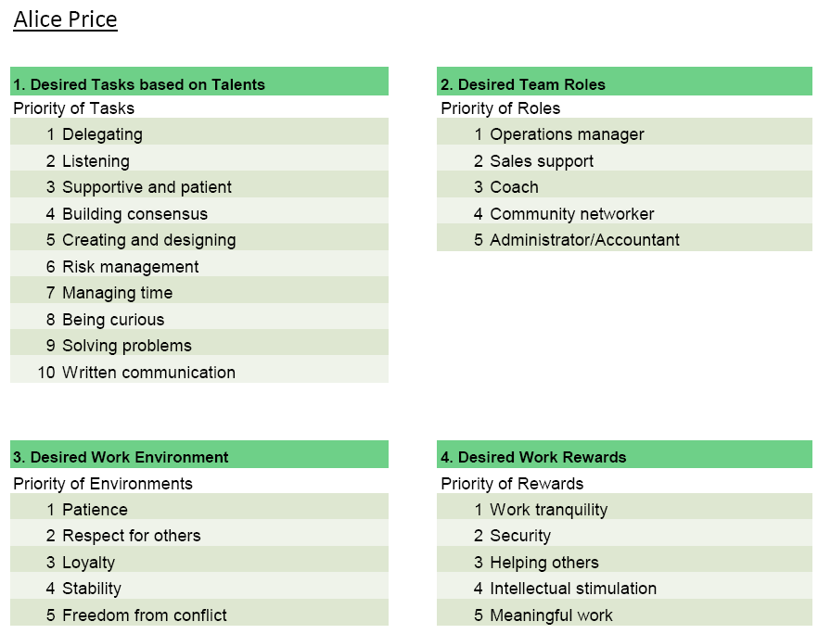
Alice Price
The Relationship Builder

Slide 46
Issues for Behavioral Interview
Tech Support Position
Stability
Ability to communicate
Enjoys working in a team
Patient
Thorough
Likes to implement
Builds relationships
Responds to questions
Passion

Slide 47
Position 4:
Typical Administration Role Requirements
Depending on the business, an administration oriented role will generally require the person to play a more back office role inside the business. The role will include:
Managing budgets – manages costs
Researching information – investigating
Managing time - completing projects on a timely basis
Reviewing details – checking details
Administration – looking after paper work
Risk management – compliance
Analyzing data – organizing information
Supportive and patient - responds to client queries
Follows procedures - manages back office functions

Slide 48
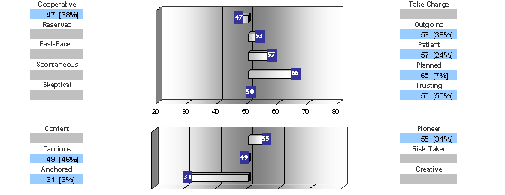
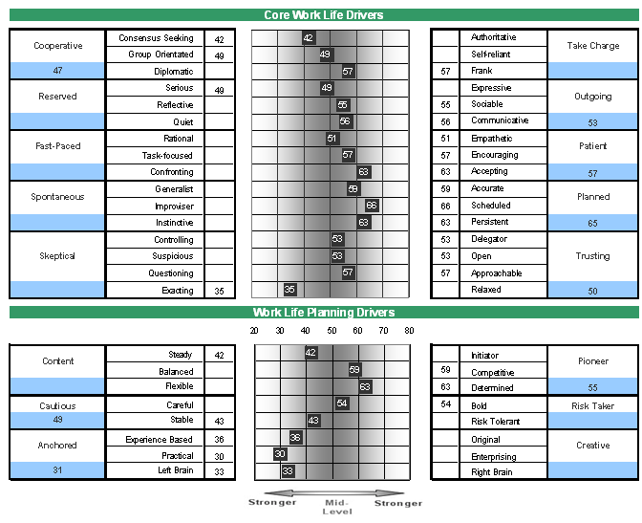
Tom Jordan
The Reflective Thinker

Slide 49
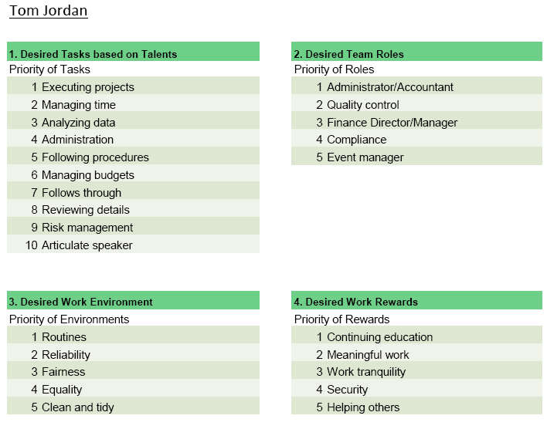
Tom Jordan
The Reflective Thinker

Slide 50
Issues for Behavioral Interview
Administration Position
Stability
Detailed
Analytical
Can work alone
Ability to plan
Patient
Follows procedures
Passion

Slide 51
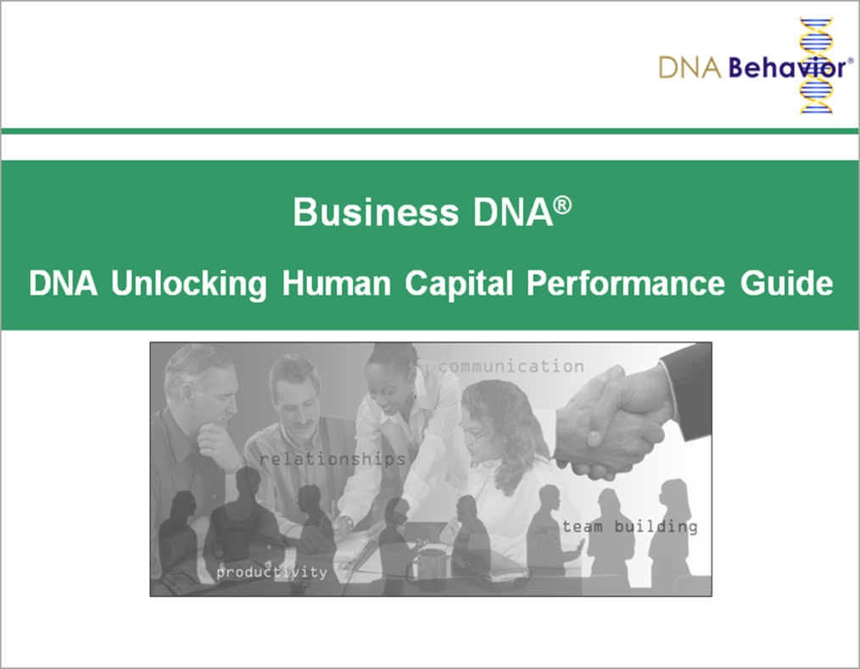
Contact Us
For more information about
Business DNA:
Contact:
DNA Behavior
5901 Peachtree Dunwoody Rd
Suite A375
Atlanta, GA 30328
(866) 791-8992
inquiries@dnabehavior.com
www.businessdna.com
`

