Slide 1
Behaviorally SMART Team Performance Forming & Storming Stages – Case Studies

Slide 2
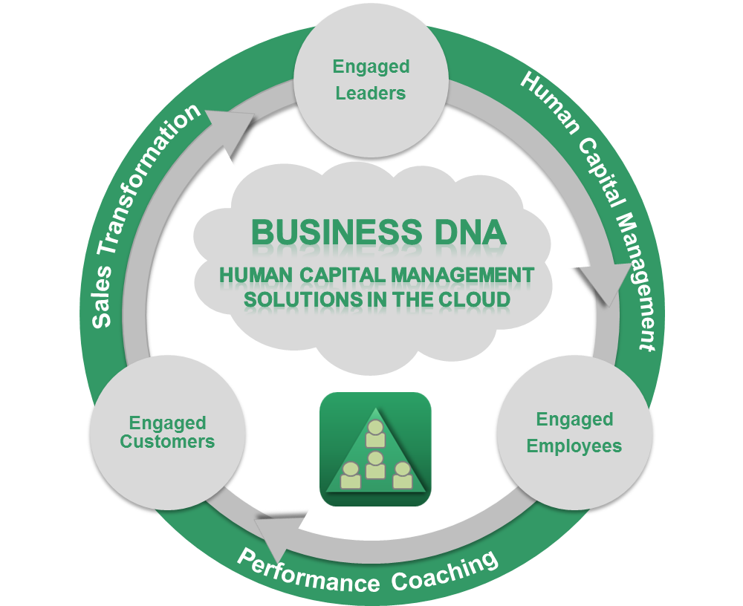
Behavioral Intelligence Platform Managing Human Capital

Slide 3
Today’s Webinar Objectives Part 2 of 4
Through behavioral discovery understand, develop and productively use human capital for transforming personal and team performance
Understand that Behavior, Communication and Learning style is hard-wired but can be “influenced”
Start with Self-Awareness and understanding why natural behavior matters in the workplace
Become a “Leader” using Adaptation to improve results from teammates.
Leverage team differences helps drive better results and minimize stress
Improve client service and increase revenue through team cohesiveness.
Hiring Process and Team Performance through Forming, Storming and use of reporting in Case Studies.

Slide 4
Closing the Behavior Performance Gap for Teams
+70%
Team Productivity Gains*
+70%
Team Productivity Gains*
Team Growth Drivers:
Operational Competence
Team Results
Team Leadership
Team Communication
Customer Engagement
Supplier Engagement
Team Growth Drivers:
Operational Competence
Team Results
Team Leadership
Team Communication
Customer Engagement
Supplier Engagement
Team Sustainability Drivers:
Team Trust
Team Values
Team Sustainability Drivers:
Team Trust
Team Values
*2009 Gallup Research

Slide 5
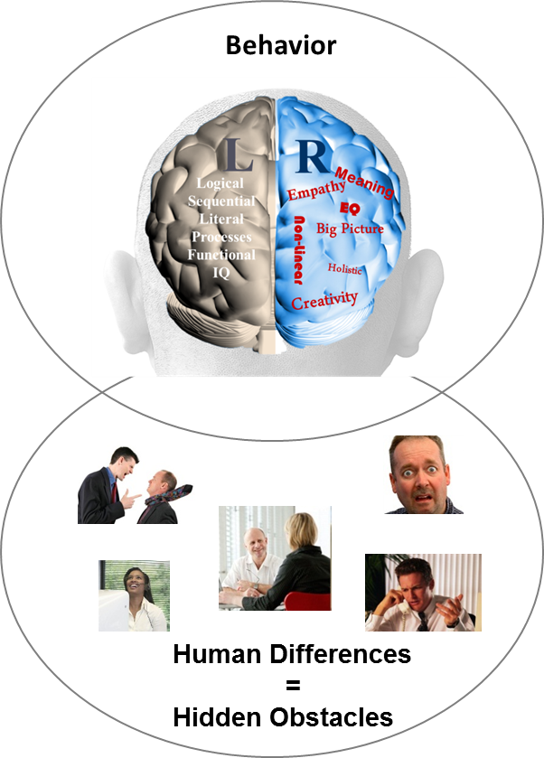
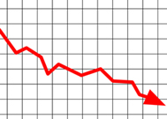
Behavior Causes Business Performance Challenges
87% of
measurable business issues are communication related
Sales Conversion
?
Client Engagement
?
Employee Retention & Productivity
?
Operational Execution
?
Business
Performance
Source: Harvard Business Review 2002

Slide 6
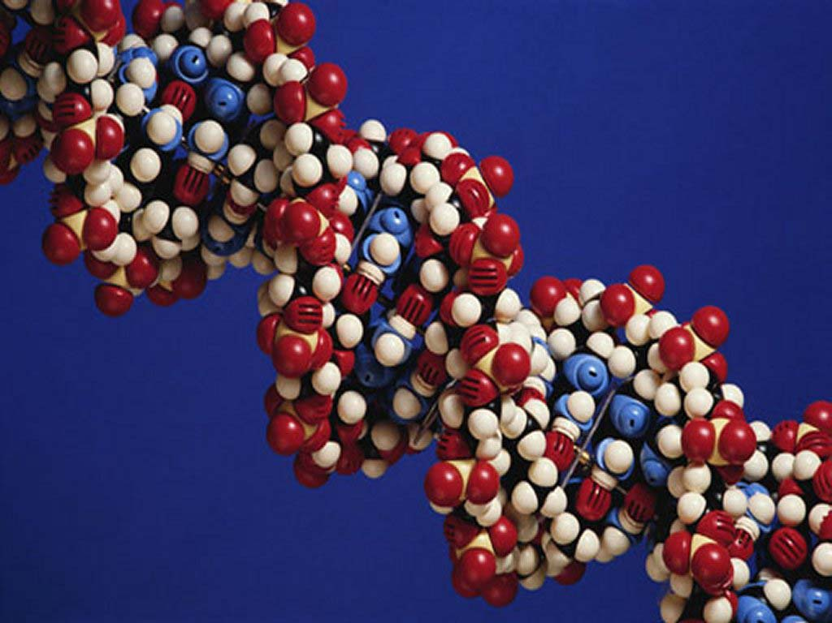
DNA Behavioral Style What Is Your Natural Behavioral Style ?
Each person has a unique natural behavioral style
The natural behavioral style along with personal environment (history, experiences), values, and education shapes our overall personality
This impacts every business, career, financial and life decision that we make
Every person has the desire to be understood on a deeper level

Slide 7
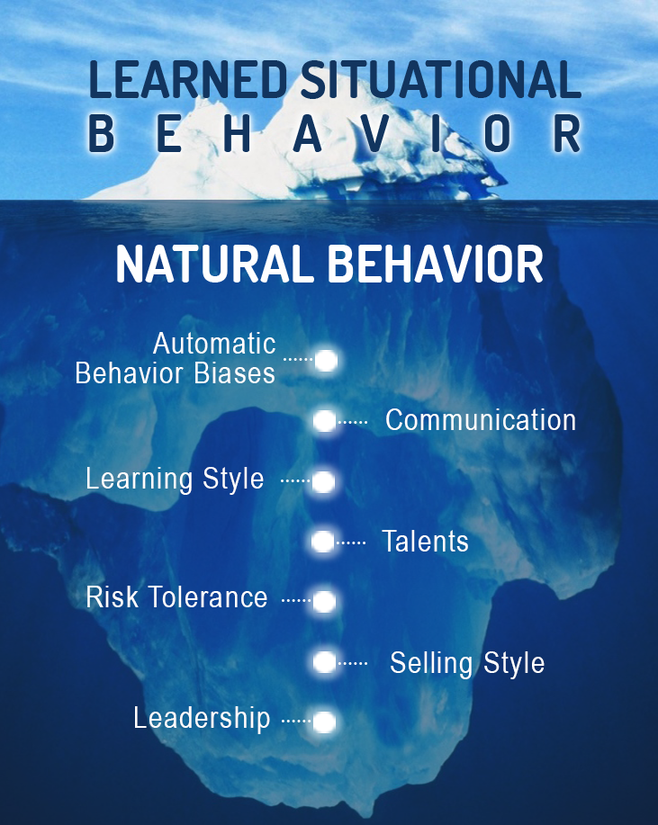
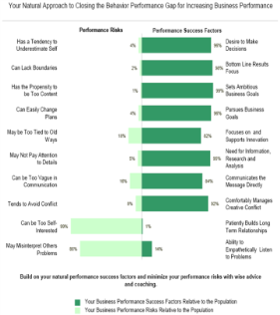
Predict Employee & Customer Reaction to Life, Business Events A Quicker and More Reliable Method
Observations
Do Not Get
Below the
Surface
Business DNA
Natural Talent Discovery and Performance Measurement
(10 to 12 mins)

Slide 8
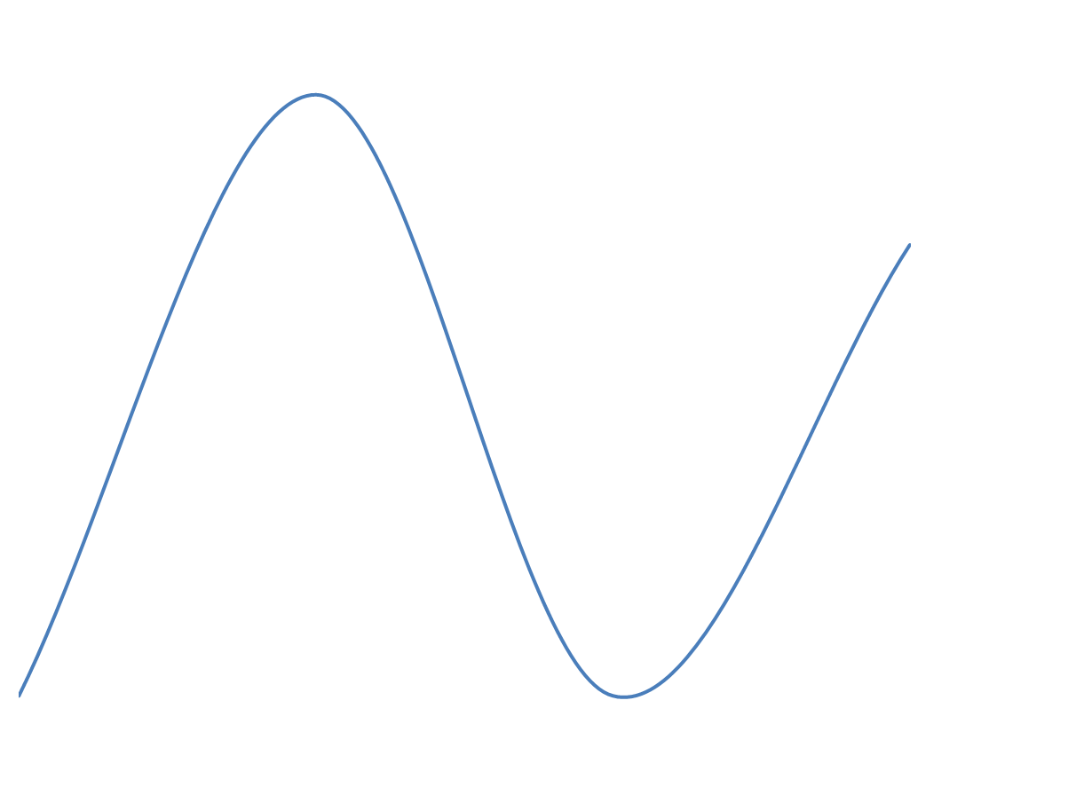
Behavioral Centered Approach
To Performance
Skills
Knowledge
Experiences
Environments
Learned/ Modified Behavior
Traditional Tool Starting Point
Confidence
Personal Performance Potential
Natural DNA Behavior – Unique Natural Talents
Instinctive Normal “Go To”
Personal Performance Impediments
Skills
Knowledge
Experiences
Environments
Our Unique Starting Point
Low Self Belief
Learned/ Modified Behavior

Slide 9
Discovering Your Performance Attributes
LEVEL C
Education, Training, Experience
LEADER- SHIP SKILLS
WORK SKILLS
COMPETENCIES
LEVEL B
RELATIONSHIPS
RESULTS
Business DNA Natural Behavior
NATURAL BEHAVIORAL TALENTS
Heredity and Environment
LEVEL A
CHARACTER and INTEGRITY
Trustworthy * Authentic * Emotionally Stable * Passion, Values, Purpose Driven

Slide 10
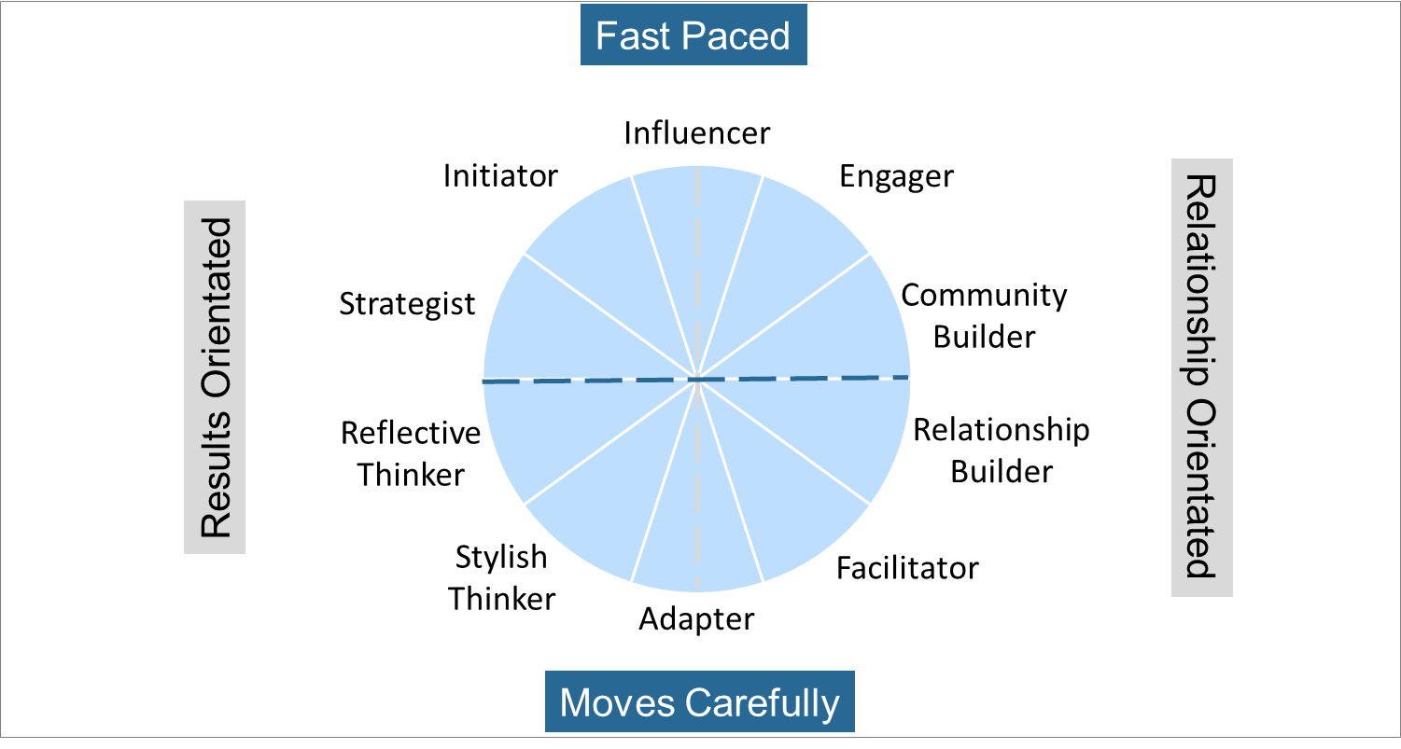
Summary of Natural DNA Behavior – 10 Unique Styles

Slide 11
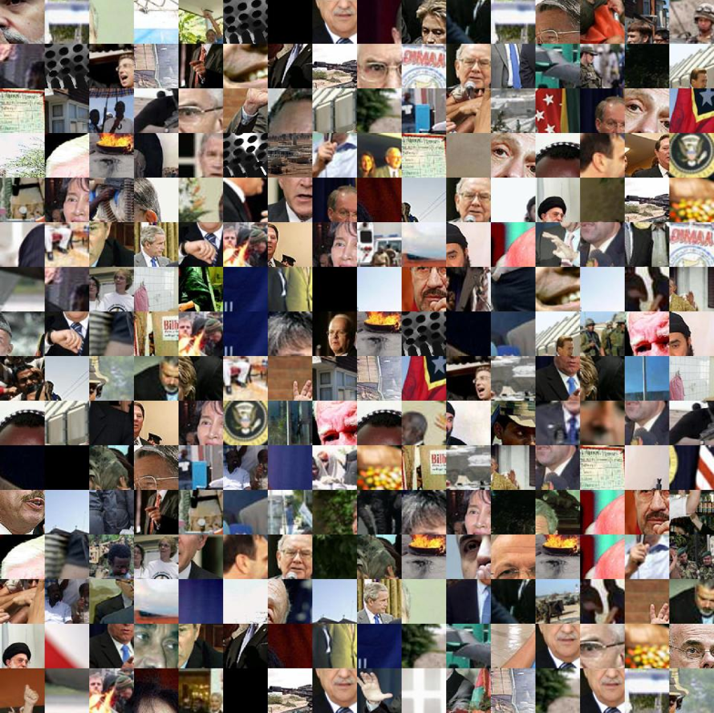
Do You Know Who You Are Working With?
Notes:
11

Slide 12
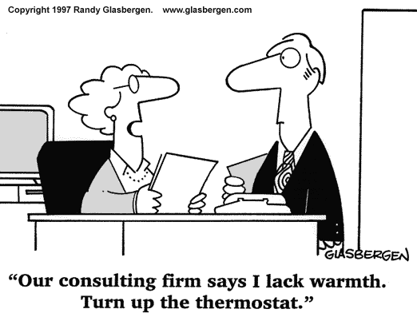
Building Sound Relationships
To build sound relationships you need to:
Know how to adapt your communication to meet the other person’s terms. Empathetically demonstrate your understanding of them when communicating.
Be aware of how your strengths and struggles can impact the other person. Be prepared to adapt your style.
Transparency builds trust. Be able to openly share of yourself to build trust: “knowing me-knowing you”. Openly admit your strengths and struggles.
Honest appraisal and feedback

Slide 13
DNA Team Performance Model
TRUST
D
I
F
F
E
R
E
N
T
C O M M U N I C A T I O N S
T
A
L
E
N
T
S
UNITY
ALIGN
Team Success
UNDERSTANDING
ACCEPTANCE
RESPECT
TRUST
ALIGN
C O M M I T M E N T
UNITY
TRUST
Team Development:
From Diversity to Unity to Success

Slide 14
Summary of Natural DNA Behavior – 10 Unique Styles
Goal Setting
Lifestyle
Information
Stability

Slide 15
Four common advisor team structures Developed by Bruce Tuchman
Four common advisor team structures Developed by Bruce Tuchman
Performing
Norming
Storming
Forming
Source: https://www.mindtools.com/pages/article/newLDR_86.htm
Notes:
Forming, Storming, Norming, or Performing.
If you’re forming, you’re likely a younger team, still in your growth phase. You’re beginning to hire, you’re bringing on a new associate, or you’re purchasing a new book of business.
If you’re storming, you’ve got your team members in place, but it’s a grind. Either you’re not communicating well as a group, your team can’t seem to grasp the vision you have for your business, or there’s downright insubordination.
If you’re norming, there’s a sense of peace about you, no major conflicts, everyone pulls their weight. Awesome.
Performing though, is the real sweet spot, and only about 10% of teams actually get there. Performing teams are composed of people who not only pull their weight but actively contribute to the vision you have for your business and take pride in doing so. They bring a sense of energy into work with them every day, and the clients can FEEL it. Sounds pretty good, doesn’t it? So why do so few teams get there, and what can you do about it?
There is no one-size-fits-all answer to this question, but I can talk to you a little bit about how some of these issues can be addressed.

Slide 16
Teams in the forming stage
Resist the urge to hire someone just because they have a pulse and the basic skills you need to fill the position
Run a comparison report to ensure that your candidate balances out your strengths and weaknesses
Ask the selling advisor to take both assessments If you’re looking to purchase a book of business,
Notes:
If you’re currently a forming team, this is actually kind of awesome because it enables you to construct your team thoughtfully from the ground up. The number one mistake a team will make in the forming stage would be to hire someone with a pulse because they had the basic skills to fill a position. One great capability within Business DNA is the Team Report function – one each member of your team takes the assessment, we can take a look at your team’s combined strengths and weaknesses, and make sure you bring someone on who balances you out – regardless of the position you’re trying to fill. Another way to look at this would be, if you’re looking at purchasing a book of business, how could you use insights you glean from their DNA to anticipate where during the transaction the seller might experience stress, and then customize your communication accordingly?

Slide 17
Hiring Performance Challenges
Hiring “Round Pegs in Round Holes” – Matching talent to the role
Building a recruitment process that leads to ongoing employee engagement
Notes:
Now lets start taking you on the path to DNA Advisor Performance. I will start walking you through the methodology using the case study of Chris Coddington, which is laid out in my Financial DNA book.
The issue I have seen for most advisors and clients is seeing through the clutter and confusion to choose between the many options that exist.
Choosing what is an opportunity goes back to your life purpose…..Your life purpose is at the core of your decision making matrix for building a quality life and your business. Getting in touch with your life purpose will help you align your natural talents, passions and values to what you do every day. Everything else is a distraction and an energy drain. When you get to understand this you will really feel it.
Having a concrete written plan based on your life purpose will help you focus on the opportunities and minimize these distractions. This is what we help you create using behavioral insights as the starting point.

Slide 18
DNA Hiring Performance Process
1. Build a Positive Hiring Culture based on a defined belief system and clear processes
2. Identify the Role knowing the talents required based on current team member behavioral styles and activities to be performed
3. Create Role Benchmark by reviewing the behaviors for the role based on successful performers
4. Match Talent to the Role by having the candidate complete their Natural Behavior Discovery before first interview
5. Match to Manager by comparing the strengths and struggles of the Manager and Candidate
6. Conduct Behavioral Interview using powerful questions based on the strongest behavioral factors

Slide 19
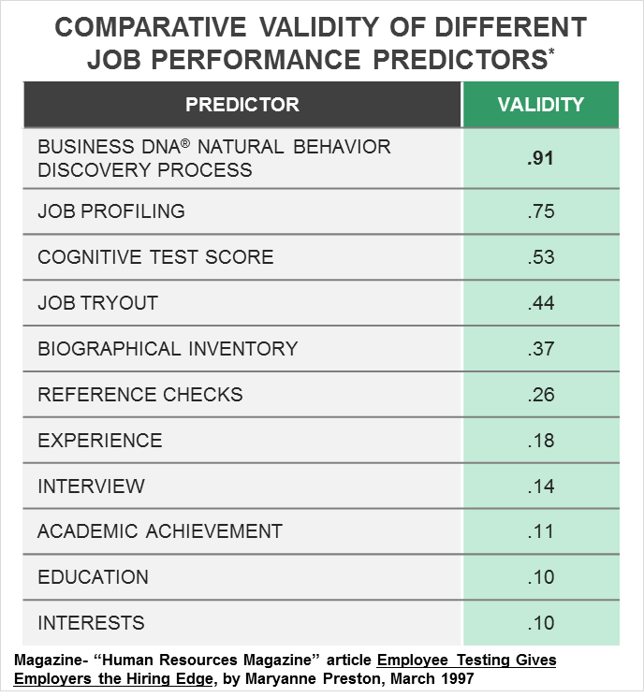
Business DNA as the Foundation of a Robust Behavioral Hiring Process
Aptitude and Personality Assessments
Increase accuracy of a successful hire to 53%
Job Profiling
75% Accurate
Interview process alone
only 14% accurate
Studies by John Hunter, Ph.D., Michigan State University

Slide 20
Behavioral Awareness
Strengths, Struggles and Mid-Range
Objective behavioral awareness is a critical starting point to your workplace performance transformation. Playing to your strengths consistently will maximize your potential. Although, strengths over-played can become blind-spots.
Strengths - Behaviors that come naturally and which should be used. Note: Strengths over used can become a struggle.
Struggles – Behaviors that can be managed with
greater awareness of your natural behaviors. Struggles not managed can become a weakness.
Mid-Range Scores - Tend to be more flexible in these factors. Easier to move left or right.

Slide 21
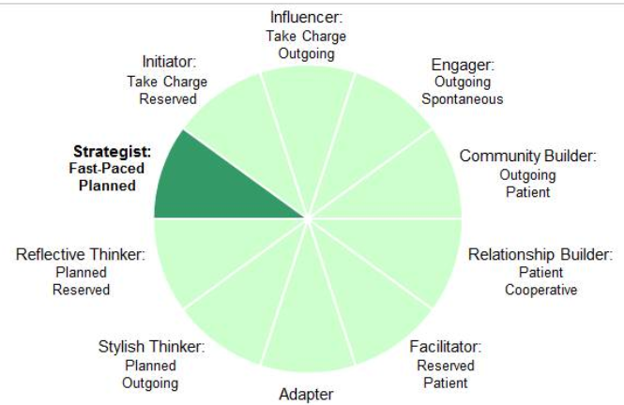
Practical Analysis of the Key Talents that Drive Performance
10 Unique Natural Workplace Styles based on 8 Primary Factors and 24 Sub-factors
Customized DNA Ultimate Performance Guide

Slide 22
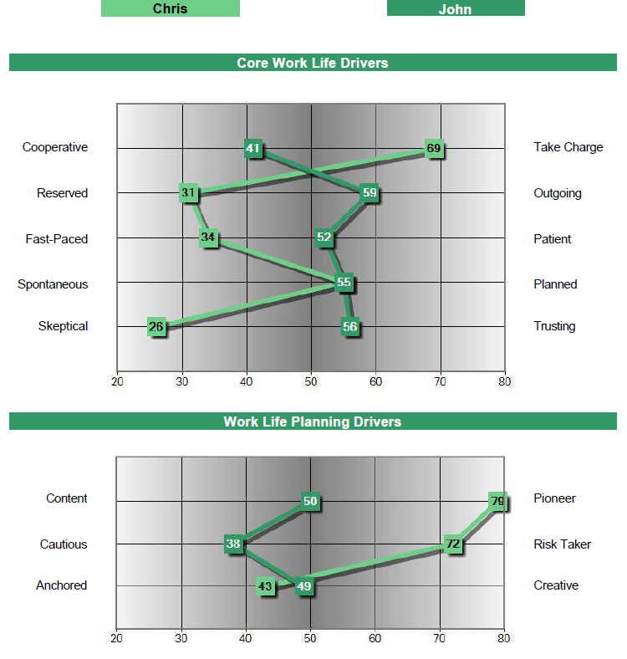
Chris Coddington & John Smith Comparison Graph
Strategist
Stylish Thinker
Many Behavioral Differences to Navigate:
Chris may not provide John with the personal engagement he needs
John could be far more content and cautious than Chris’s pushy goal driven style

Slide 23
TEAMS IN THE STORMING STAGE
Teams storm when individual behaviors, biases, decision making styles, and communication styles are out of sync.
Your team’s Natural Behavior is triggered by this environmental stress, and it’s demonstrated in an unhealthy way
If you can sense the tension, it’s likely that your clients can too
Start with the Team Report as a means to get all of the issues out on the table in a safe setting
Notes:
If you’re currently storming, I’m sorry to hear that, but don’t worry, these issues can be untangled. We just need to take the engine apart, clean it, and put it back together. Teams begin to storm when individual behaviours, biases, decision making styles, and communication styles are out of sync. There’s a case study at your place setting that I’d encourage you to take a look at to understand why these issues exist, and how they can be resolved with a little give and take. All human beings have a desire to be understood on a deeper level, and when we’re not, and we feel our boundaries are being violated, resentment sets in – on both sides. If you feel your team is currently storming, it’s likely that you work within a larger team. I would warn you against hiring new people until you’re able to identify where the crack is in your foundation, and fix it. The danger within a storming team is that if you can sense the tension, it’s likely that your clients are feeling it too. Much of this work is self-awareness. Just getting these issues out in the open, in a safe setting, can be the key to alleviating some of this pain.

Slide 24
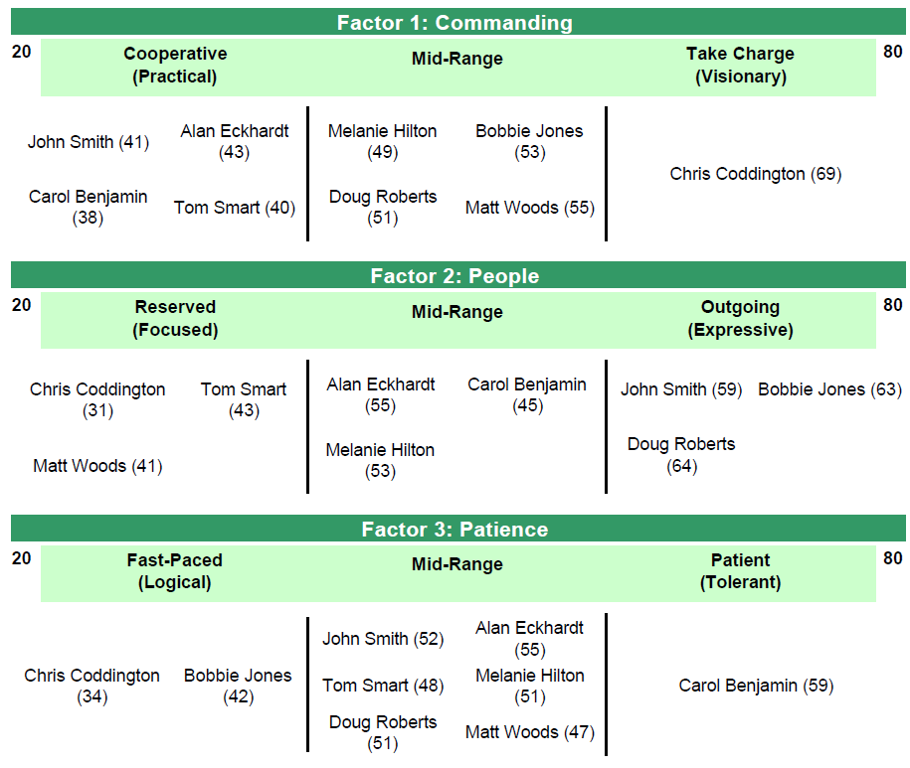
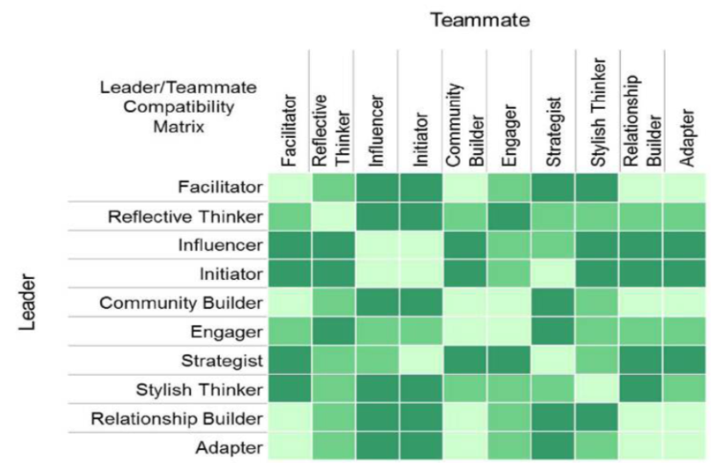
Review Your Business DNA Team Report
Core Work Life Drivers
Leveraging Team Talents for Success
Hiring and Aligning Top Talent
Understanding, Accepting, Respecting Differences for Enhanced Team Work
Team Compatibility Matrix

Slide 25
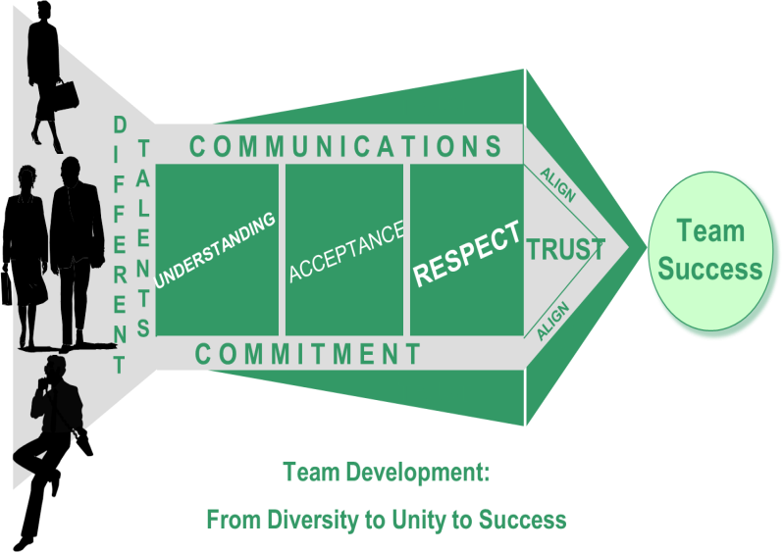
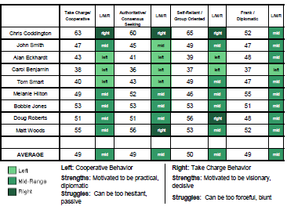
Identifying Team Differences for Building a Productive Team
The Business DNA Team Report makes understanding team dynamics easy by:
Identifying the different talents of team members
Providing graphical analysis of team differences
Summary of Results and Relationship drive differences
Identifies strengths and struggles of team members for role matching
Summary of how to communicate with each team members

Slide 26
TEAMS IN THE NORMING STAGE
Communicate the vision you have for your business, and ask for their help to turn your vision into tangible goals
Regularly ask for their input, and listen while they give it to you
Incentivize your team members in a way that is meaningful to them
Notes:
If you’re norming, that’s great! And some would say, Kaitlyn, I’m fine with norming, I don’t want to fix what isn’t broken, and I get that. I will warn you that James Butler will do a number on you later about The Cost of Comfort. But there is a huge opportunity here, and the difference is made by getting your team’s buy-in.
Have you communicated the goals you have for your business to your team, so that they can feel a sense of ownership over your cause? Do you have an incentive piece in place? Let me clarify: I’m not talking just about bonuses and raises. DNA Behaviour is able to prioritize rewards that are most appealing to each team member. Many times it’s continuing education, public acknowledgement, and inclusion in business building conversations that gets team members excited. So I would encourage you, if you think your team is comfortably norming, to start looking at ways you can better your best and really find your competitive advantage.

Slide 27
Teams in the performing stage
Performing teams have equal balance of results-oriented and relationship-oriented individuals.
They represent a host of skills that can solve to any need your clients might have.
PROTECT YOUR CULTURE
Notes:
Performing teams have an equal balance of results-oriented and relationship-oriented people. For that reason, their combined team profile is usually ‘Adapter.’ My advice to performing teams would be to protect your culture. Before making a new hire, have me run a theoretical team report for you to make sure that their behavioural biases are not going to swing you from your power position as a performing team, to one that starts to suffer from behavioural mismatching.
I have a cool story for you. Donna, our Receptionist, took the DNA assessments and when she was done, she couldn’t stop talking about it. I asked her what about the experience got her so excited, and she said “I’m a Community Builder. My job isn’t just to answer the phone or greet people or support the mailroom. Yes, I do those things, but by doing them, I build a sense of community. THAT’S my unique ability.” Those of you who know Donna, know that she’s happy all the time, but I swear her smile got BRIGHTER. DNA isn’t meant to just put a spotlight on what you LACK – it’s meant to show you where you SHINE.

Slide 28
First Break All the Rules
Build Up Your Teammates - Key Points:
Capitalize on differences (diversity) to build strong teams
By nature, differences divide
We need each other:
Shared/complementary talents
Teams need trust
Trust leads to unity
Understand self
Understand others, and
Accept
Respect & Appreciate
Align
Trust
Seek to Meet Their Communication Style
Bottom line = Teamwork
Great managers offer this advice:
Focus on each person’s strengths and manage around their weaknesses… Help each person become more of who they already are. This radical insight is fueled by one simple insight: Each person is different.
What the world’s greatest managers do differently.
By Marcus Buckingham and Curt Coffman, 1999 by Simon & Schuster

Slide 29
The 6 Pillars of DNA Team Performance
1.Leader Review For the Leader to Understand their Natural Leadership Talents to Build a Healthy Team and Identify the Team Issues for Increasing Revenues
2.Team Member Review
For Each Individual Team Member to Understand their Natural Talents for Performing their Role in the Team
3.Team Meeting
A Team Meeting to Align the Team for Greater Productivity to Achieve Team Goals
4. Team Relationships
Each Team Member to Learn How to Adapt their Communication to Engage and Interact With Others in the Team
5. Leader Coaching
For the Leader to Lead from the Front and Coach Each Team Member Based on their Unique Talents
6.Team Monitoring
Quarterly Team Reviews to Monitor Team Performance and Health
Notes:
29

Slide 30
ACCEPTANCE, UNITY & DIVERSITY
Necessary Ingredients of a Healthy Team
Same
Mission
Commitment
Corporate Values
Opportunity/Loyalty
Policies/Discipline
Different
Talents
Motivations
Ideas/Interests
Needs
Styles

Slide 31
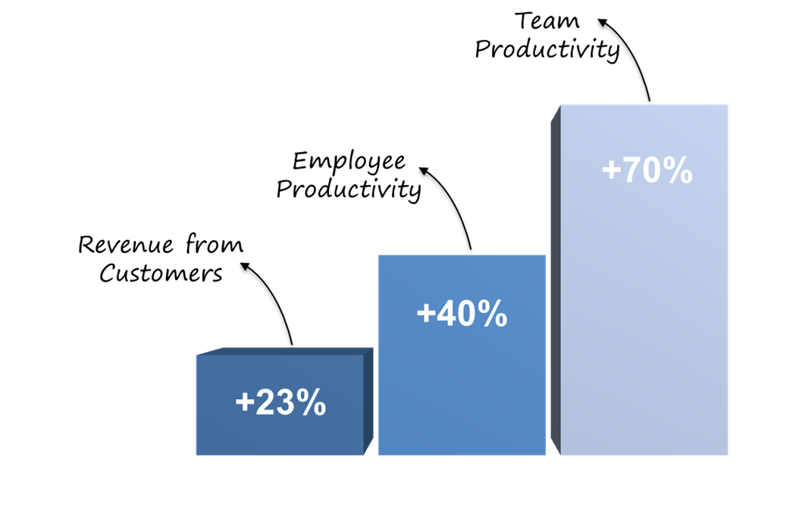
Team Performance
Benefits
Some Indicators of Employee Engagement:
Turn up on time and are reliable
Feel understood by their manager
Want to work for their manager
Follow the company plan
Ask questions when they need help
A Proven Methodology
Our experience and independent research shows this approach leads to improved employee productivity by up to 40% and team productivity by 70% and sustainable revenue growth by more than 23% a year.

Slide 32
Now is the time to capitalize on your strengths as a team
Notes:
As the industry becomes more complex, now is the time to capitalize on your strengths as a team and build a solid foundation for growth.

Slide 33
Examples of applied team performance
Once the behavioral awareness is developed in the team, we have specialized programs in the following areas:
Succession planning
Assimilating new leaders and team members
Scaling back office to support growth
Change management
Establishing goals and priorities

Slide 34
Behavioral Products Resource Tour and Monthly Features
http://www.businessdna.com/products/
Blog: http://blog.dnabehavior.com/
Case Studies: http://www.businessdna.com/benefits/#2
Our focus here at DNA Behavior in 2017 is to identify the natural instinctive behavioral talents that are very stable over time. Most other tools focus on the other components of personality that are dynamic in different circumstances.
The natural behavior provides a reliable predictor of how a person will consistently perform over the longer term using their talents, make decisions with the least stress, respond to different life and work factors that change, and where they will “go to” under pressure.
Notes:
Make reference to:
Whitepapers and book
30 days trial – register on website

Slide 35
Business DNA® for Behavioral Insights Using a Validated Psychometric Platform
A Tailor Made Suit for Every Client
Since 2001, we have been providing business services worldwide with a single cloud-based “HRTech” platform which delivers practical and scalable behavioral intelligence solutions to “Know, Engage and Grow” every manager, employee and client online for the building of a client-centered business which delivers high performance.

Slide 36
The Science DNA Systems
Powerful and Unique Client Centered Behavioral Solutions Delivered in 123+ Countries and 11 Languages
Forced Choice Assessment Measuring 64 Behavioral Traits
60+ Man Years of Development Investment Since 2001
Independent Validation by Team with 100+ Years of Experience

Slide 37
Featured
Featured
The Behaviorally SMART Webinar Series
August’s Featured Webinar Series:
Behaviorally SMART Team Performance, Part 3
Tuesday, August 29th @ 11 AM
https://register.gotowebinar.com/register/5988593818011889411
Part 3 focuses on Learned Behavior and the Storming phase of Team Development
- And we introduce the team summary report – all the individual behavioral insights brought together as a team.
Quickly and reliably remove the guesswork of building enhanced relationships with employees and clients to unlock human potential The key component of improving business performance is understanding personal talents, and continuously focusing on unique strengths to maximize revenues, productivity, and profitability on a sustainable basis.
Notes:
Make reference to:
Whitepapers and book
30 days trial – register on website

Slide 38
Questions? Contact Us
For more information about DNA Behavior
Contact:
DNA Behavior International
5901-A Peachtree Dunwoody Rd
Suite 375
Atlanta, GA 30328
(866) 791-8992
Leon.morales@dnabehavior.com
http://www.businessdna.com/discovery-trial/
www.businessdna.com
Read our Blog: http://blog.dnabehavior.com/
Please follow our groups:
- LinkedIn at Financial Personality Insights
- Twitter @FinancialDNA
Notes:
Make reference to:
Whitepapers and book
30 days trial – register on website

